Slide 1

CAN Connect Presents:
GET CONNECTED:
Putting Compassion
Into Action

Slide 2
Our Mission:
To foster collaborative opportunities to creatively address community needs in Anoka County.
www.compassionactionnetwork.org

Slide 3
Thanks to our hosts at the
Fridley City offices:
City Manager Wally Wysopal
Mayor Scott Lund
Director of Community Services
Deborah Dahl

Slide 4
Guest Speaker:
Jaime McKenzie Senior Program Manager for Social Responsibility
UnitedHealthcare
“Do Good. Live Well.” Employee Volunteer Program

Slide 5
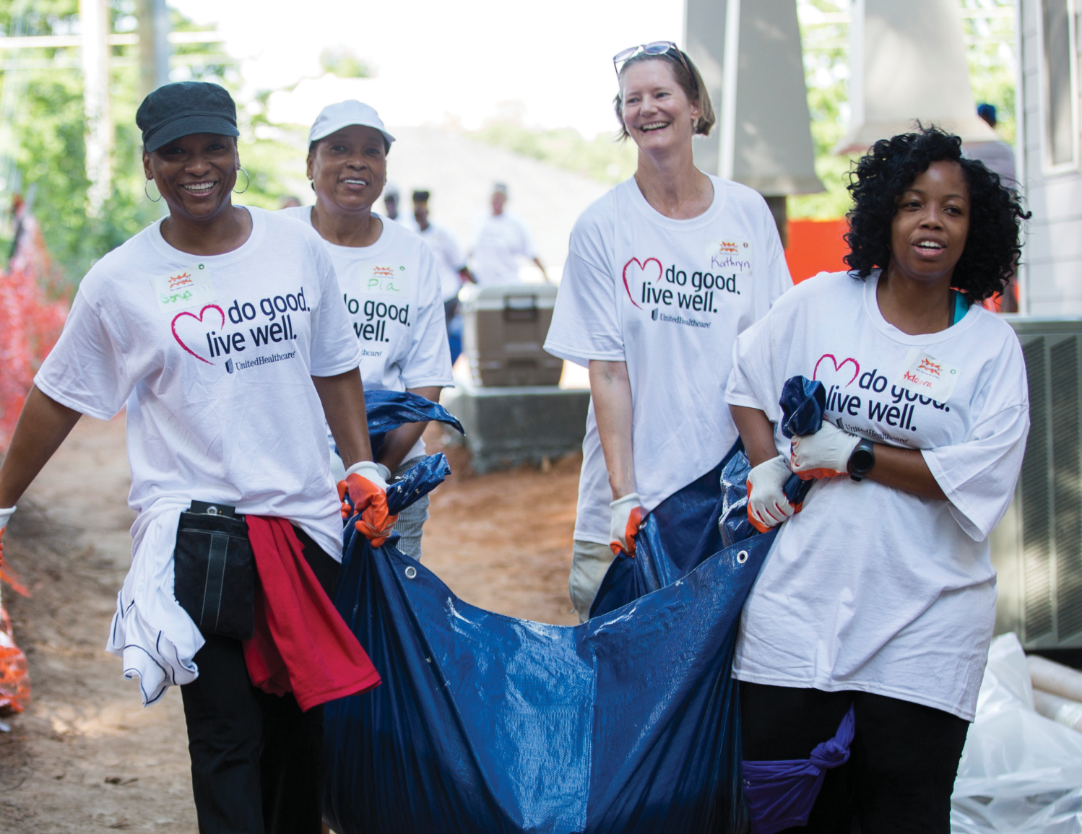

GET CONNECTED:
Putting Compassion Into Action

Slide 6
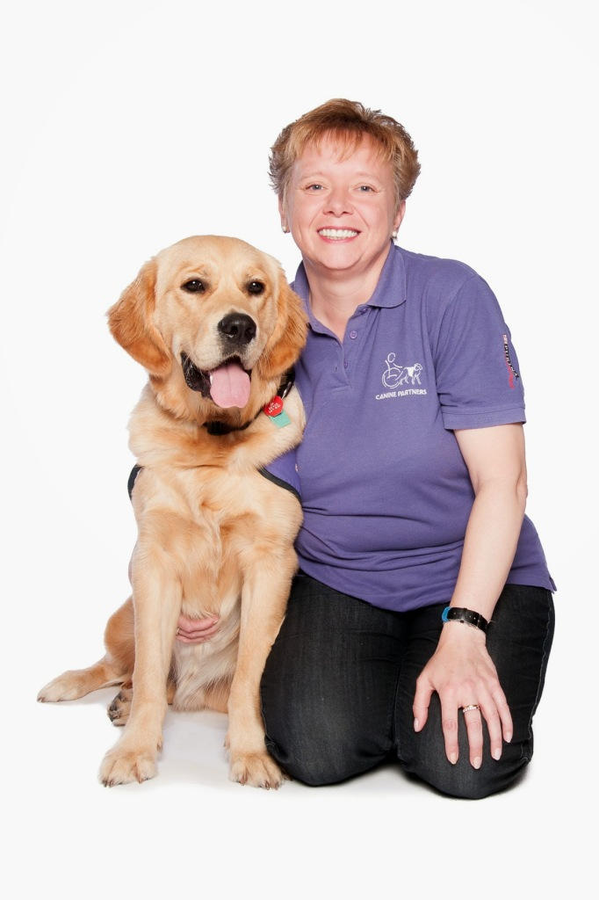

How volunteering
saved a life.
Notes:
This is Jacqui…since 2013 Jacqui has been volunteering for the charity Canine Partners, an organization in Scotland that trains dogs to help PEOPLE WITH physical disabilities lead a more independent life. As a puppy parent, she takes a young puppy from the age of eight weeks and has it in her home for 12-14 months before handing it back to the Charity for advanced training. During that time she will take it to weekly puppy classes, socialize it, teach it basic manners and obedience and do continued training with it.
Jacqui says that Canine Partners, quite simply, saved her life. Jacqui suffered from severe clinical depression for more than 20 years and struggled with a dependency to painkillers which caused many secondary health problems. Jacqui worked, raised a son and was married but was barely clinging to a life where she no longer recognised the person she had become. Gradually it all came undone, her marriage fell apart and she became so ill with depression, panic attacks and anxiety her doctor signed her off of work. Despite her best efforts over the next three years she struggled to get well and eventually in 2010 she lost her job of 23 years. Jacqui then became addicted to pain killers and eventually tried to take her life twice. After a long recovery her Mom told her about Canine Partners and her life was forever changed.
Jacqui said: “Having a dog and the support of Canine Partners means I have a focus now. I cannot reach the low point I reached before. Canine Partners is my ‘Purple Army’. They are my second family. They saved my life and they change so many others. My story with Canine Partners will never end. I love what I do it’s that simple. These dogs, this Charity and what it brings to people will always touch my heart. It gives me meaning and a reason to believe that the world is in fact quite a nice place filled with some really nice people.”

Slide 7
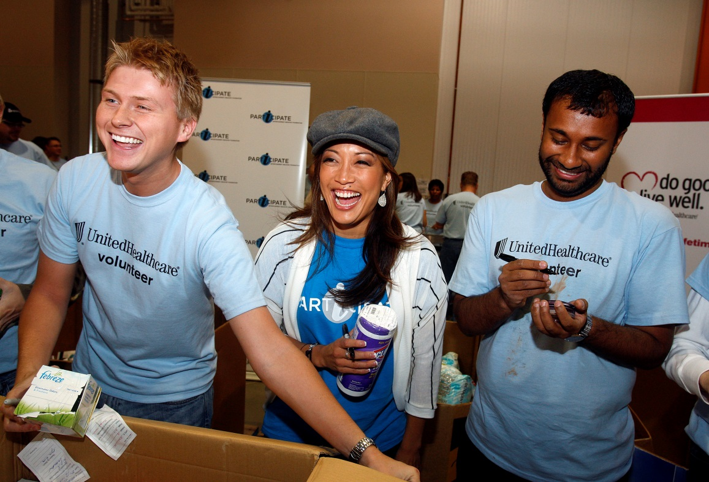
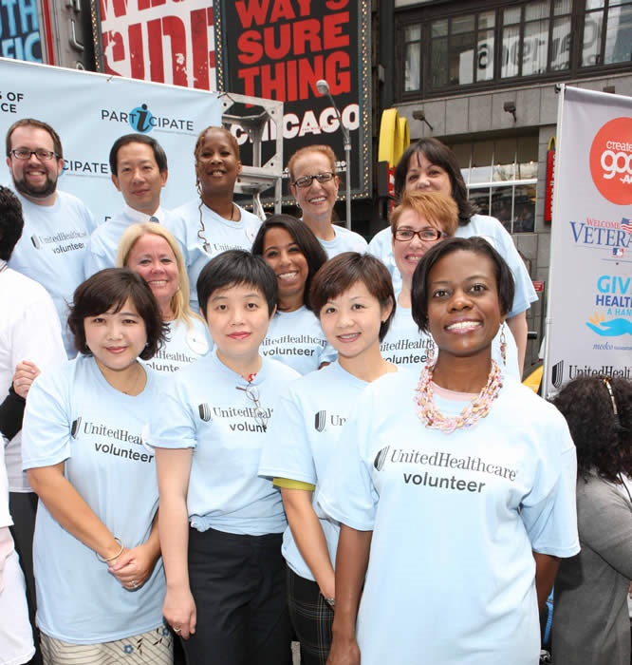
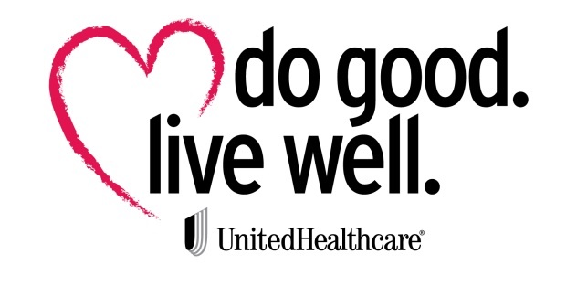
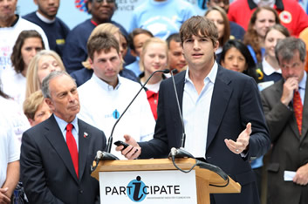
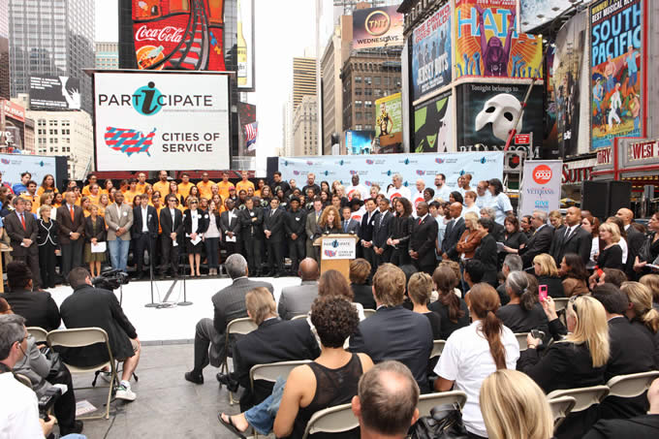
Notes:
Do Good. Live Well. was created with the help of the first volunteer study we did with VolunteerMatch which showed how doing good helps you live well – hence the name “Do Good….Live Well.”. It could be debated that nothing promises as many personal rewards as volunteering does. More and more studies are demonstrating our physical and mental health can benefit in many ways through volunteering. BUT back to the study…all started in the summer of 2009 when President Obama asked Americans to help in the nation’s recovery by volunteering in their communities.
Later that fall, the Entertainment Industry Foundation created a campaign called iParticipate to help inspire a new era of service and volunteerism in the entertainment community. The multi-year campaign hoped to make service a part of who we are as Americans and show what we can achieve when we all pull together.
UnitedHealthcare already saw the value in volunteerism and thought they could make a bigger impact promoting it if they could show how volunteering positively impacts not only those on the receiving end but ALSO those on the giving end. So in 2010 we asked VolunteerMatch as the volunteer experts to join us in doing the study, and as we hoped, the data showed volunteering does indeed positively impact health and well-being.

Slide 8

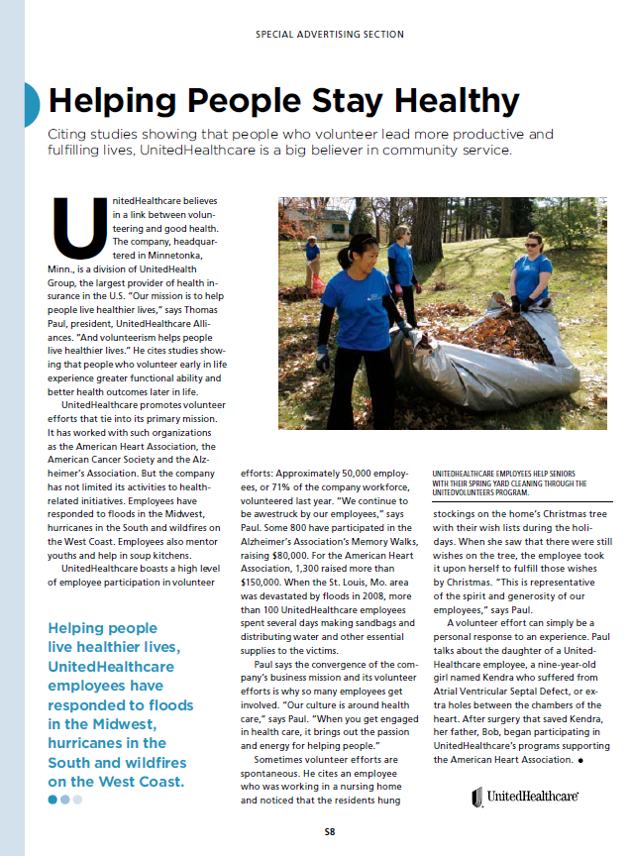
Entertainment Industry Foundation
Notes:
Here’s a clip from our study featured in TIME magazine

Slide 9


iParticipate
Notes:
And this is one of the PSA ads we did with Gwenyth Paltrow that appeared in various magazines . We also did a PSA video with Gwenyth and her mom, Blythe that aired during popular prime time shows on CBS, ABC, and more.

Slide 10
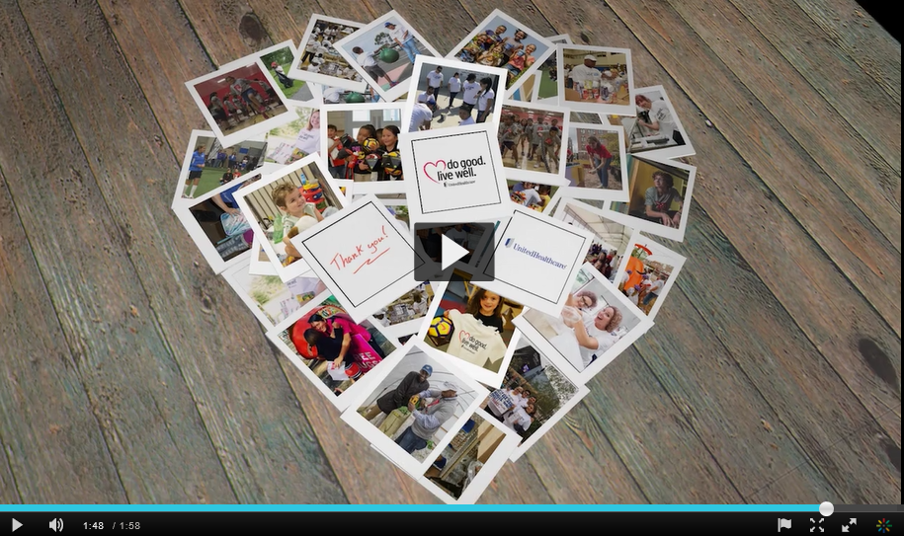
UnitedHealthcare in our Communities

Slide 11



Do Good. Live Well. – 2018 by the Numbers
55 volunteer projects in
28 cities & 19 states with 64 partners
Over 1,600 volunteers contributed 6,900 hours
38,100 kids will have a safe place to play over the life of the 3 playgrounds we built
More than 20,000 sq. ft. of fitness space activated, impacting 8,125 kids annually
More than 3,300,000 meals provided to our hungry neighbors through volunteer participation in food drives & through work in food banks, agencies and mobile pantries

Slide 12
The study
DOING GOOD IS GOOD FOR YOU
What are the dimensions of volunteering?
Who is volunteering?
How often? Where? Why?
What are the benefits of volunteering for volunteers?
How does volunteering impact health?
What did we want to learn?
Notes:
More and more studies are demonstrating our physical and mental health can benefit in many ways through volunteering. The 2017 Doing Good Is Good for You Study, in partnership with VolunteerMatch, once again affirms these results: from feeling better to enhancing well-being and providing a sense of personal enrichment and satisfaction (in other words, being happier), “doing good” is good for you. Let’s not forget that people who are happier live longer!
Dimensions of Volunteering
As was seen in 2013, about one-third of US adults have volunteered formally (for an organization) in the past 12 months.
As a group volunteers are volunteering less than previous years and are working with fewer organizations
Who Volunteers?
The composition of volunteers has remained relatively consistent over time.
Lapsed volunteers are older and more often unemployed.
New formal volunteers are substantially younger than volunteers generally.
Benefits of Volunteering
As was seen in 2010, the majority of volunteers attest to the benefits of volunteering.
Most gain satisfaction from helping others, and appreciate the opportunity to socialize and learn about oneself and the world.
Most believe that volunteering yields health benefits, but does not specifically help to manage chronic illnesses.
Why Do People Volunteer and What Do they Do?
Volunteers want to make a difference, but also appreciate the personal benefits of volunteering.
Most new formal volunteers have an opportunity to utilize skills developed in the workplace.
Time is the greatest constraint for volunteering.

Slide 13
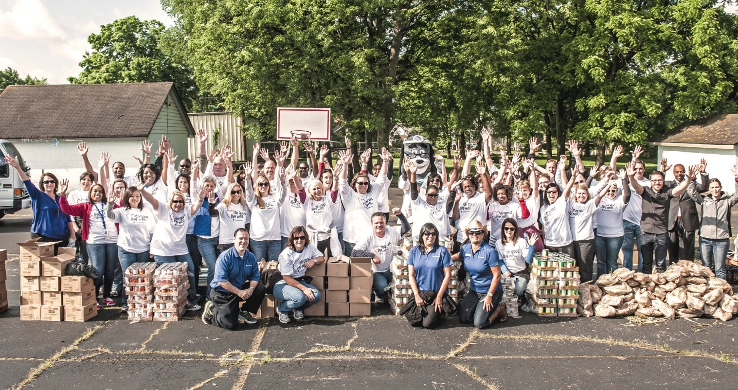
Research methodology
The findings from this study are based on a national survey of 2,705 adults age 18 and over conducted by Kantar TNS, one of the world’s largest marketing research firms. Kantar TNS conducted the online survey between Nov. 29 and Dec. 12, 2016. This study is the third in a recurring research effort for UnitedHealth Group, parent company of UnitedHealthcare, beginning in 2010 and repeated in 2013.
Data was weighted to ensure a representative sample of the total U.S. adult population.
2,705
adults surveyed
7

Slide 14
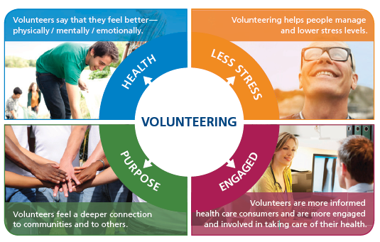
DOING GOOD IS GOOD FOR YOU.
Notes:
The benefits of volunteering fit into four main groups:
Health: Volunteers feel better all around – physically, mentally, emotionally.
Less Stress: Volunteers are better equipped to deal with stress and report lowered stress levels
Purpose: Volunteers report having a greater purpose in life and stronger, deeper connections
AND, Engaged: volunteers are more engaged and feel more in control of their health
Volunteering isn’t just something healthy people do. Everyone can reap benefits. Our study involved a representative sample of adults across the country:
young, old, in good health and in poor health.
Remarkably, we see older individuals and those who suffer from multiple chronic conditions taking on volunteering—and feeling better as a result.

Slide 15
Volunteering has a proven positive effect on
our physical and mental health.

Slide 16
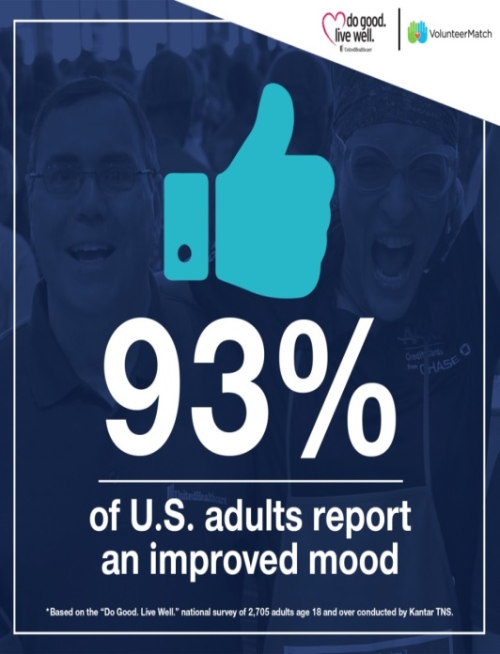
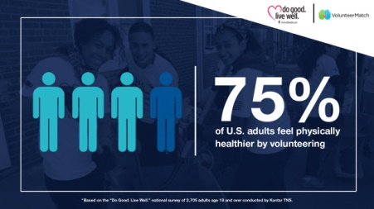
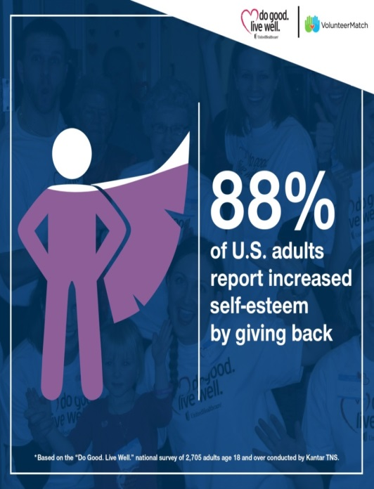
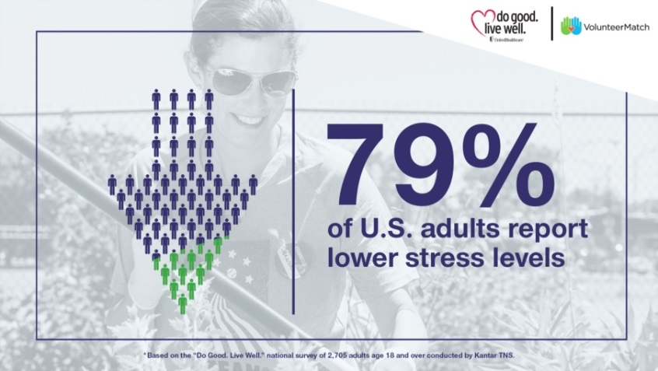
Physical & Mental Health Benefits
Notes:
Three-quarters (75 percent) of people who volunteered in the past 12 months tell us volunteering has made them feel physically healthier. More than one-third
(34 percent) of those who volunteer find participating in this activity helps them better manage their chronic illnesses. Compared with those who have not volunteered in the past 12 months, volunteers are significantly more (78 percent) likely to feel they have control over their health.
Hispanic volunteers are even more likely to report feeling physically healthier (72 percent versus 55 percent for non-Hispanics) and better able to manage their chronic illness (48 percent versus 25 percent for non-Hispanics) through their volunteer activities.
A Carnegie Mellon University study found adults over 50 who volunteered on a regular basis were less likely to develop high blood pressure, a major risk factor for heart attack, stroke, heart failure and metabolic syndrome.¹
Volunteers are less likely to be obese than non-volunteers. Since 2013, the rate of obese non-volunteers has increased while the rate among volunteers has remained constant.

Slide 17
Volunteering provides intrinsic benefits, which enrich our
lives beyond our expectations.

Slide 18
Intrinsic Benefits
94%
of volunteers report an enriched sense of purpose
  Volunteers are more likely than non-volunteers to socialize in various ways and to do so more frequently.
  Volunteers report greater social adjustment and emotional well being.
89%
of volunteers report an expanded worldview
85%
of volunteers have developed friendships through volunteering
4
Notes:
Most volunteers report an enriched sense of purpose in life (94 percent), an expanded worldview (89 percent) and having learned valuable things about themselves (88 percent) from their volunteerism. In fact, volunteers have consistently higher scores (by about 15 percent) than non-volunteers on nine well-established measures of emotional well-being including personal independence, capacity for rich interpersonal relationships and overall satisfaction with their life.
So it comes as no surprise that this healthier, more fulfilled outlook is accompanied by added social benefits. Volunteers note developing friendships through their volunteer activities (85 percent). They also report having a higher capacity to enjoy socializing compared with those who do not volunteer.

Slide 19
We’re spending less
time volunteering.

Slide 20
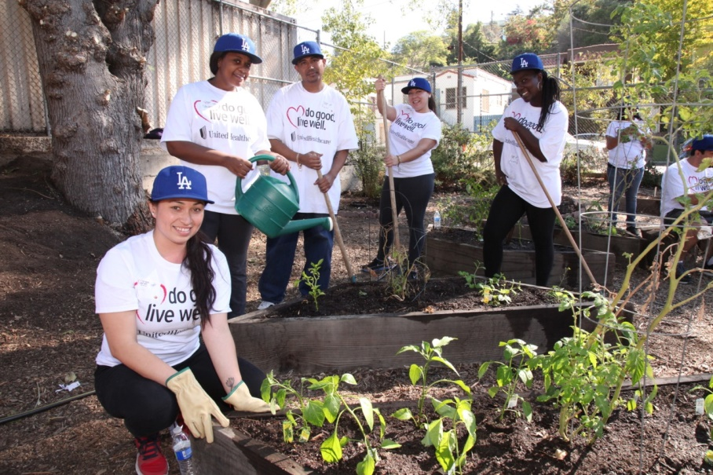
Get involved!
FINDING MEANINGFUL VOLUNTEER EXPERIENCES
Follow your interests and passions.
Apply your skills and experience.
Don’t get overwhelmed by time commitments and the nearly unlimited opportunities.
Learn more and find opportunities at DoGoodLiveWell.org
Download the article: http://bit.ly/2ljgMhG
Test your knowledge: http://bit.ly/2llAlpt
6
6
Notes:
Volunteering provides benefits beyond measure. Communities are stronger and volunteers feel good about their contributions. The intrinsic benefits of helping others foster physical and emotional health, as well as a strengthened sense of well-being. Happy, well-adjusted people become more productive, collaborative employees, and more supportive, positive family members. And when employers encourage these efforts, they earn greater respect from their employees.
Finding the right volunteer opportunity is important — look for something that matches your interests, personality and expertise. UnitedHealthcare’s “Do Good. Live Well.” initiative is aimed at inspiring a new level of service and volunteerism in communities across the country.
The “Do Good. Live Well.” website, dogoodlivewell.volunteermatch.org, offers tools to search and sign up for volunteer opportunities in partnership with VolunteerMatch. As might be expected, finding volunteer opportunities via a website or other online sources has seen the largest growth (from 5 percent in 2010 to 23 percent in 2016).

Slide 21
The Seven Practices of an Effective Employee Volunteer Program
PLAN
  Have specific societal, employee and business goals with clear strategies, focused efforts and tactics to achieve them.
DESIGN
  Leverage employee skills and corporate assets, enhance corporate operations, and adopt structures and policies that allow them to scale and deepen engagement.
LEADERSHIP
  Effective programs benefit from vocal and continual support from company leadership that specifically promotes and furthers the program’s mission, goals, and plan.
PARTNERSHIPS
  Strategic partnerships and collaboration with government, private, and nonprofit partners.
EMPLOYEE ENGAGEMENT
  Generate broad-based employee enthusiasm, support and stewardship for the program and enrich the employee work-related experience as demonstrated by increased morale, productivity, retention, workplace skills and/or other indicators of engaged employment.
MEASUREMENT
  Measure against plan, including the processes that are performed effectively and the level to which the program achieves outputs, accomplishments, and business and social impact. These results are shared internally and externally.
SUCCESS & GROWTH
  Recognize, communicate and celebrate success internally and externally while continuously learning from peers, volunteers and partners and reflecting on potential program improvements.
Adapted from http://www.pointsoflight.org/corporate-institute/resources
6

Slide 22
Questions
& Answers

Slide 23
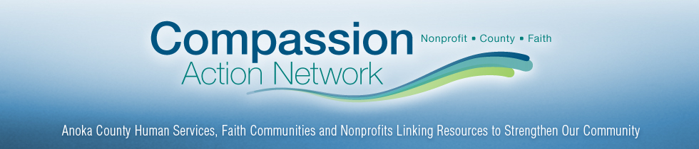
Panelists:
RYAN GEORGE Fridley Police Deputy Director &
Roland “Pete” Peterson Grace Evangelical Church
Fridley Cops & Clergy Program

Slide 24
Panelist:
Tricia Lehti,
Anoka County RSVP Coordinator,
Retired and Senior
Volunteer Program

Slide 25


Anoka County RSVP
Notes:
Thank you all for inviting me to speak briefly about Anoka County Retired, Senior and Volunteers Program!

Slide 26
What is RSVP?
RSVP stands for Retired and Seniors Volunteers Program which matches interested volunteers to local and meaningful opportunities.
It is part of a federal (national) initiative to engage retirees in volunteering throughout the usa.
Anoka County RSVP has been in existence since the program inception of 1973.
Notes:
Our program started with less than 50 volunteers serving in schools, administrative roles, completing mail projects to leading Tae Kwan Do classes.

Slide 27
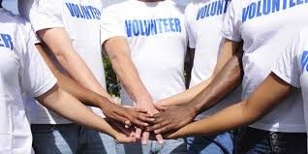
Anoka County RSVP Today
450+ active volunteers are enrolled with our program today.
Volunteers may serve at one or more partnership(s) called a “station”.
Volunteers are crucial for our stations to meet critical needs in the community.
Notes:
We partner with over 50 different organizations that we call “stations”.

Slide 28
Partial List of volunteer Stations include…
Acbc, nace, Saca & The Salvation Army food shelves.
Family caregiver connection
Tamarisk
Family of promise
Stepping stone emergency housing
Ac medlink
Hope 4 Youth/HOPE PLACE
Lee Carlson Center
Metro North Adult basic education
Income, property & mobile home tax preparers
3 meals on wheels programs
manna markets (blaine, & Fridley)
RISE
Banfill-Locke & Rum River Arts Centers
Mercy/unity hospital
American red cross
Springbrook nature center
Umn extension services
Maaa Health insurance counselors
Help At Your Door
Wishes and more
Notes:
We partner with over 50 different organizations that we call “stations”. We meet with organizations to determine volunteer activities and if those activities are serving local needs with local volunteers. E.g. FMSC is not an option as one of our partners because it serves people outside of Anoka County.

Slide 29
Who benefited from service provided by rsvp volunteers?
226 people received information from health insurance volunteers
13,428 individuals reported increased access to food from volunteers serving in food shelves.
3,451 Seniors received services which enabled them to remain independent.
4,007 people received assistance in filing their income, property and mobile home taxes which resulted in $2.6 Million in local tax refunds.
Notes:
These are 2018 results. In an average year volunteers tend to serve about 59,675 hours of service.

Slide 30

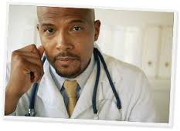
Volunteering benefits your health
A study by the corporation for national and community service (CNCS) reveals that volunteers reap health benefits when helping others. Here are some positive effects on physical and mental health:
Greater longevity
Higher functional ability
Lower rates of depression
Reduced incidence of heart disease
Notes:
Many RSVP volunteers report they feel they receive more than what they give when volunteering. Often times this may be because of a change in perspective, a sense of purpose, accomplishment or feeling of belonging with other volunteers.

Slide 31
What are the benefits of joining RSVP?
Health rewards
Ability to try many opportunities, learn new skills, or try something different, or meet new people
Invitations to workshops/training and recognition events
Quarterly newsletters to know what immediate volunteer needs or special events that come up
Notes:
Who has volunteered before? What was your experience? What made it a good experience or bad one? - Go over the application why it focuses on finding the right opportunity.
If you currently volunteer for one of our volunteer stations you won’t have to commit to more volunteering. You would benefit by getting to know others and coming to events.

Slide 32

Thank You!
Tricia.Lehti@co.Anoka.mn.us or 763-324-1661
Notes:
Go over applications, post cards and business cards.

