Slide 1
CAN Connect Presents:
Innovative and Collaborative Programs Engaging Youth in Anoka County

Slide 2
Our Mission:
To foster collaborative opportunities to creatively address community needs in Anoka County.
If there is a topic you would like CAN to cover at the next event, please talk to us after or visit our website and send us a message
www.compassionactionnetwork.org

Slide 3
Community Panelists:
Christie Lauer
YMCA Outreach and Housing Team
David Preston
Grace Evangelical Free Church Youth Programming
Stephanie Sandvik
Spring Lake Park Schools C.L.U.E. Program
Patrick Faber
Fridley Police PAL Program
Amanda Sappa
Youth 1st Community of Promise

Slide 4
Up First:
Christie Lauer
YMCA
YMCA Outreach and Housing Team

Slide 5
YMCA Outreach and housing team
Compassion action network Presentation
February 15, 2018

Slide 6
Population we serve
Youth under the age of 24 (parenting/or non-parenting) who are experiencing unstable housing situations and are within Hennepin, Anoka, and Ramsey county.
On any given night, an estimated 4,759 Minnesota youth and young adults experience homelessness.
Youth and young adults make up 52% of the homeless population in the state of MN.
30% of youth age 24 or younger on their own
30% of homeless youth have been sexually abused.
38% of homeless youth have stayed in an abusive relationship because they did not have other housing options.

Slide 7
Examples of causes of Youth Homelessness
Family Conflict/kicked out of family home
Family lost housing
Lack of affordable housing
No credit/No rental history
Exiting foster care system (age 18)
Inability to gain approval for an apartment
-Wilder Research
2015 Minnesota Homeless Study

Slide 8
How ymca outreach can help
Basic Needs
Rental Assistance
Eviction Prevention
Housing Support and/or Coordinated Entry Assessments
Employment Resources
Referrals to other Supportive Agencies
-Wilder Research
2015 Minnesota Homeless Study

Slide 9
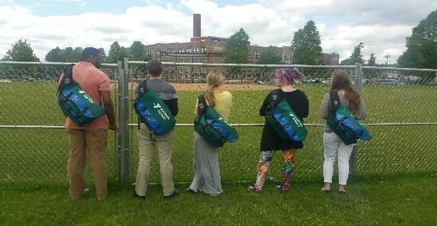
how to access YMCa services
Finding a Y worker via their presence at various community sites
Street Outreach
Get connected to a school social worker, trusted faculty, or homeless liaison
Call the YMCA Youth Resource Line (YRL) at 763-493-3052
Available from 8am to 8pm 7 days a week and 365 days a year

Slide 10
Youth resource line

Slide 11
YMCA Housing and Prevention Programs
Transitional Living Program
Communities Host Home
Eviction Prevention

Slide 12
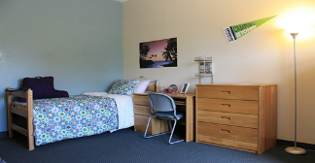
Transitional Living Program
Who: Homeless Youth 18-24
3 Main Components:
Housing Search & Identification – help them find their own apartment
Financial Assistance
Deposit
Rent Subsidy
Apartment Supplies
Life Coaching
Independent Living Skills
Financial Literacy
Education
Jobs/increasing income

Slide 13
Communities Host Home
Goal: The program connects homeless youth ages 16-24 to caring adults in their own communities who are willing to open up their homes to provide support and safe housing for at least one year. With their basic needs met by the host home, youth receive ongoing life coaching so that they can work on personal goals to become an independent and self-sufficient community member.
How we do this?
Host Home recruiting and onboarding
Host family and youth matching
Support for the Host family and
young person

Slide 14
Eviction Prevention
The Homelessness Prevention Program provides support to youth under the age of 24 currently living in Hennepin or Anoka County who are at imminent risk of homelessness due to an emergency or crisis.
Program Offers;
Prevention Specialist
Goal-oriented case management
Emergency rental assistance
Housing stabilization support

Slide 15
Our impact
In 2016 we:
Housed 94 young people and their children through our YMCA Housing Programs
Prevented 78 youth households from becoming homeless through our YMCA Prevention Programs

Slide 16
Youth Services Network app & Website
Quick and easy resources:
Shelter
Food and Clothing
Medical
Parenting
Employment
https://ysnmn.org/#/home

Slide 17
Thank You
YMCA OF THE GREATER TWIN CITIES
Youth Homelessness Outreach and Housing Team

Slide 18
Up Next:
David Preston
Grace Evangelical
Free Church
Mentorship/Discipleship Youth Programming

Slide 19
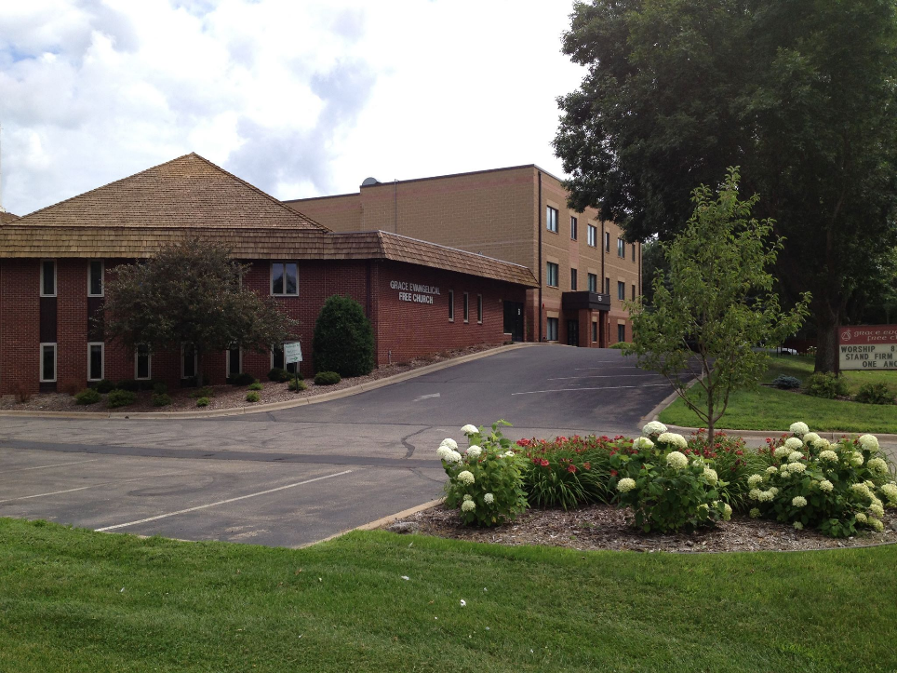
Matthew 28:19-20 Therefore go and make disciples of all nations, baptizing them in the name of the Father and of the Son and of the Holy Spirit, and teaching them to obey everything I have commanded you. And surely I am with you always, to the very end of the age.”

Slide 20
Up Next:
Stephanie Sandvik
Spring Lake Park Schools
C.L.U.E. Program

Slide 21
Youth Engagement at CLUEs
A Spring Lake Park Schools program at Fridley Terrace

Slide 22
About Stephanie…
Parent and Family Educator for SLP
Lived in Fridley for 17 years
3 Kids attend SLP Schools
Member of Fridley UMC

Slide 23
C.L.U.E.
Student & Family Advocate Update

Slide 24
CLUEs Goal:
Creating a culture that is inclusive and sustains relationships between children, families, schools, and community

Slide 25
Started with SLP staff
Early Childhood staff:
Linda Bader – ECFE home visitor
Myself
Pam Owens – ECFE room assistant
Family Advocates:
Jill Tessman
Alyssa Rademacher
Whitney Lee
Amber Turcotte
Pete Yelle – SLP Renaissance man

Slide 26
C.L.U.E. Activities
Offered Throughout the Summer at Fridley Terrace Community Center

Slide 27
Parent Conversation…
Technology Usage
Parenting Styles
Safety
Health and Wellness
Child Development
Relationships
Area Family Activities
Discipline and Consequences

Slide 28
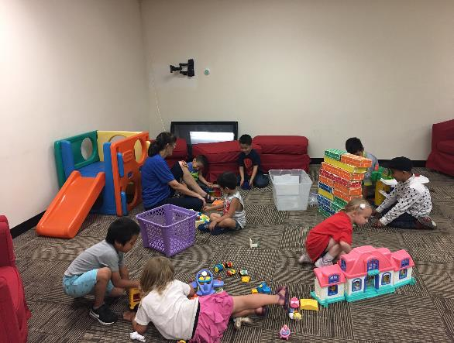
Kids’ Activities…

Slide 29
Kids’ Activities…

Slide 30
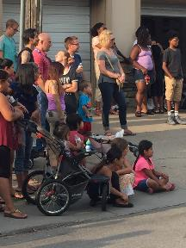
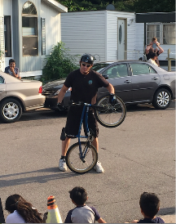
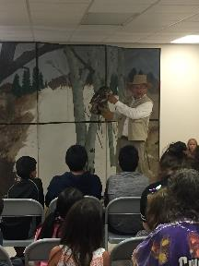
Community Involvement
C.L.U.E. Activities

Slide 31
Community Presentation…

Slide 32
Fun!

Slide 33
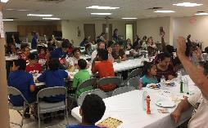
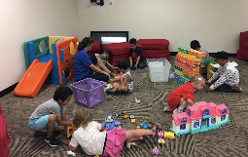
C.L.U.E. Participation
WEEKLY ATTENDANCE
Week 1 – 100
Week 2 – 95
Week 3 – 80
Week 4 – 94
Week 5 – 96
Week 6 – 94
Week 7 – 160
Week 8 – 78
Week 9 – 94
Week 10 – 149

Slide 34
Participant Surveys
C.L.U.E. 2017

Slide 35
Quotes from Parent Participants
C.L.U.E. 2017
“It is most important for my family to have positive communication, and build relationships with others in the community.”
It is most important for my children to learn new things, get along with other children, and develop positive relationships.”

Slide 36
Community Partners
Fridley and SLP Lions
Fridley PD
Blaine Soccer Club
YMCA
BSLPM Fire Department
Anoka PD
U of MN – Simply Good Eating
Critters and Co.
KARE 11 Qmmunity
Anoka County Public Health
Fridley Terrace LEO Club and youth

Slide 37
How can you help?
Provide and serve a meal
Bring your talent and engage youth in activity time
Make a donation of craft supplies
We are currently planning for the summer, so contact me today!
Call: 763-600-5937
Email: ssandv@district16,org

Slide 38
Up Next:
Patrick Faber
Fridley Police Department
PAL Program

Slide 39
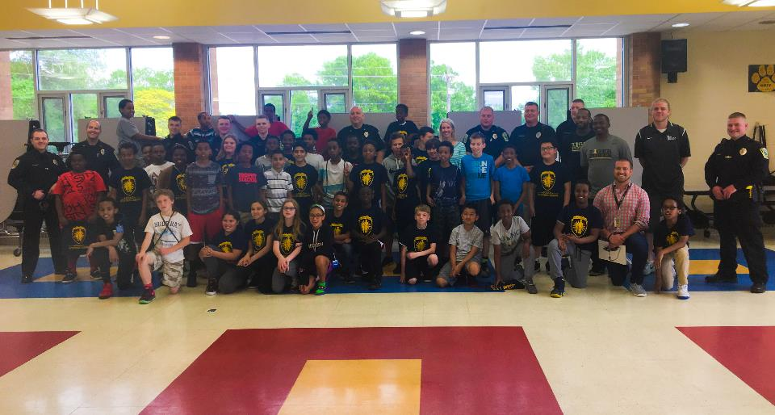
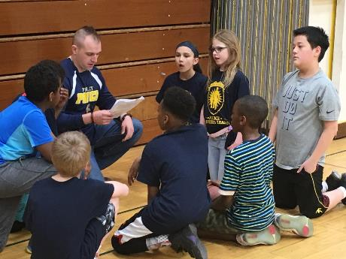
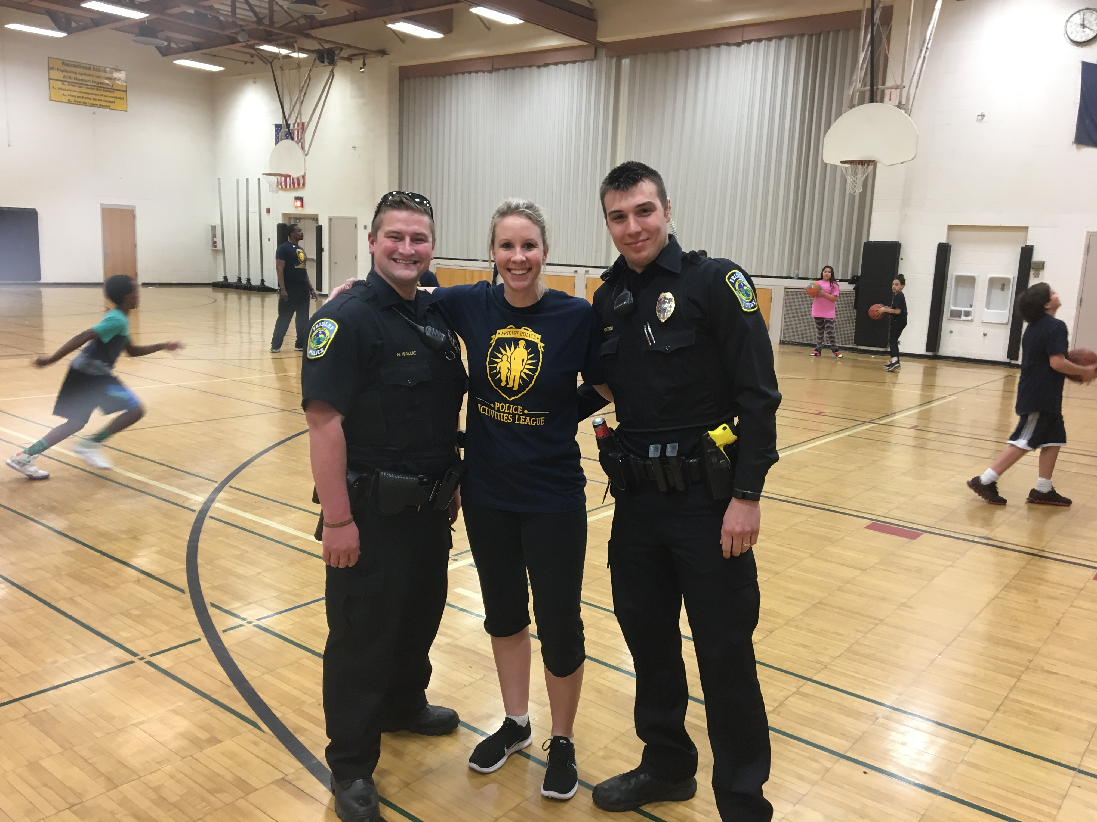
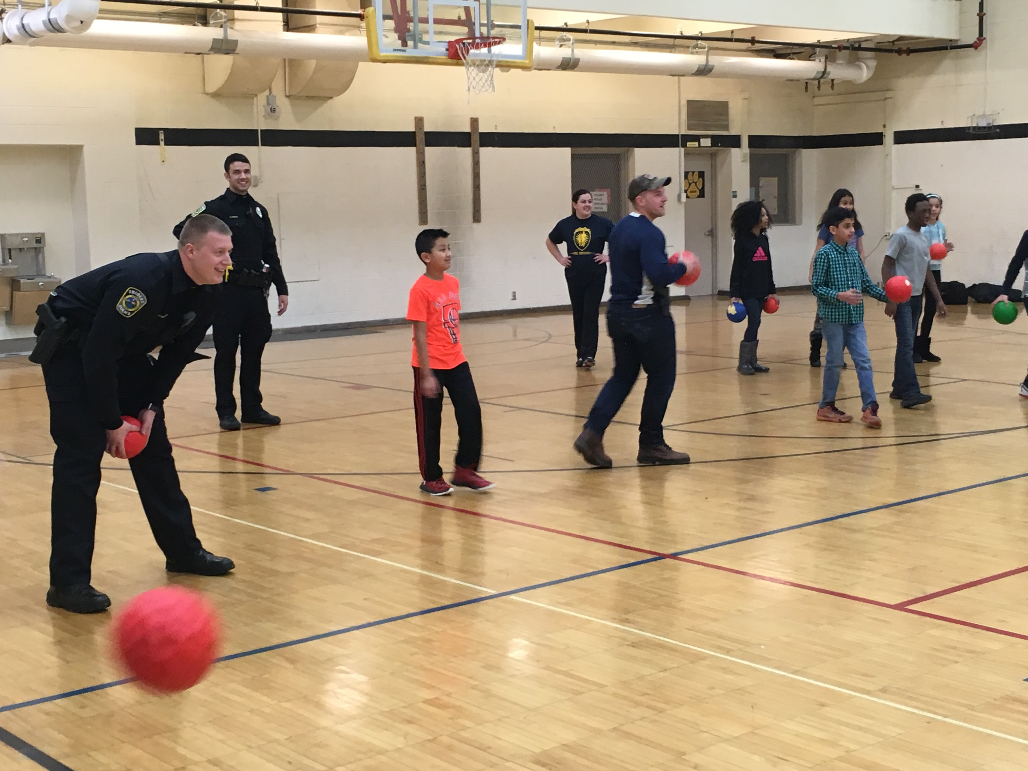

Slide 40
Up Next:
Amanda Sappa
Youth 1st Community of Promise

Slide 42
Our mission is to engage youth, their families, and the community to ensure youth have the five fundamental promises they need to succeed:
Caring Adults
Safe Places
A Healthy Start
Effective Education
Opportunities to Give Back

Slide 43
Who do we serve?
Youth ages 11-18 in Andover, Anoka, Coon Rapids and Ramsey
80% of participants qualify for Free/Reduced Lunch*
30-40% of participants are immigrants or refugees (ELL/ESL)
Programs are FREE and open to all youth in our partner cities

Slide 44
Program Summary
Core Activities
After school programs
Summer programs
School release day program
Life Skills training
Family Club
Social events
Additional Services
Intervention counseling
In-class assistance
Advocacy – in school and legal proceedings
General assistive services
Health and dental
Housing
Food
Clothing
Etc.

Slide 45
School Year Program Locations
Coon Rapids Middle School

Slide 46
How can you help?
Refer youth to Youth First
By calling 763-421-8530 or visiting our website: www.youth1st.net
Contacting our partner schools and asking for Youth First
Volunteer
After school homework help
Fieldtrips and social events
Donate
Funds
In-kind services
Supplies for youth and families

Slide 47
Our Team
Amanda Sappa, Executive Director
asappa@youth1st.net
Tony Mauren, Youth Program Coordinator
Andover High School and Anoka High School
tmauren@youth1st.net
Aaronica Jackson, Youth Program Coordinator
Coon Rapids Middle School and High School
ajackson@youth1st.net
Mateo Herrera, Site Staff
Oak View Middle School and the Ramsey Center

Slide 48
Open Q & A
to all Panelists

Slide 49
Thank you so much for attending!

