Slide 1
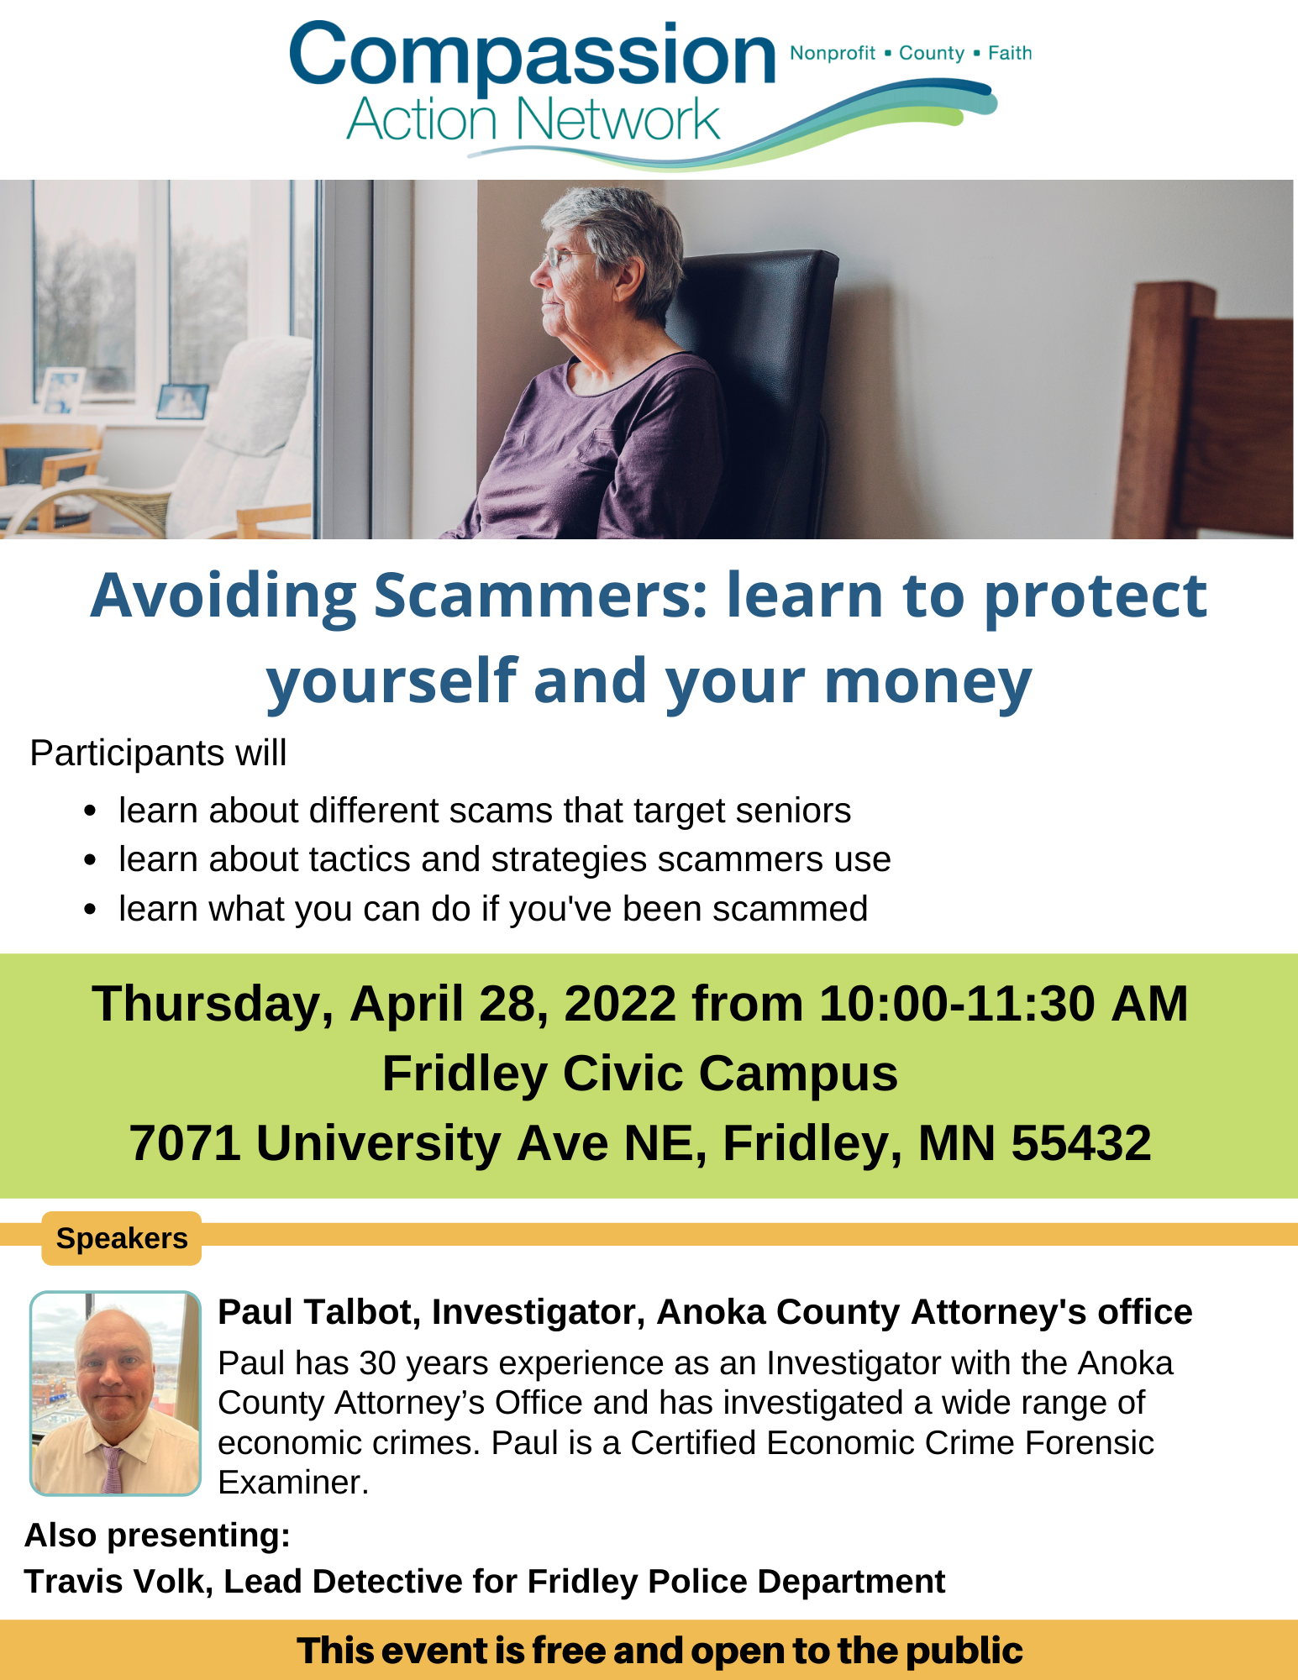
Welcome

Slide 2
Our Mission:
To foster collaborative opportunities to creatively address community needs in Anoka County.
If there is a topic you would like CAN to cover at the next event, please talk to us after or visit our website and send us a message
www.compassionactionnetworkanoka.org

Slide 3
Speakers
Paul Talbot, Investigator, Anoka County Attorney's office
Paul has 30 years experience as an Investigator with the Anoka County Attorney’s Office and has investigated a wide range of economic crimes. Paul is a Certified Economic Crime Forensic Examiner.
Also presenting:
Travis Volk, Lead Detective for Fridley Police Department

Slide 4
Scammers target seniors
Learn to protect yourself and your money
Presented by the Anoka County Attorney’s Office

Slide 5
presenter
Investigator Paul Talbot
30+ years of experience
Specialized in financial exploitation and white-collar crimes

Slide 6
Common SCAMS
Grandparent
IRS
Health insurance
Lottery/sweepstakes
Romance/dating
Charity

Slide 7
How will scammers reach you?
Phone calls
Emails
Texts
Mailings
Door-to-door

Slide 8
tactics & strategies
Emotion
Secrecy
Speed
Biggest jerk you ever talked to / best friend ever

Slide 9
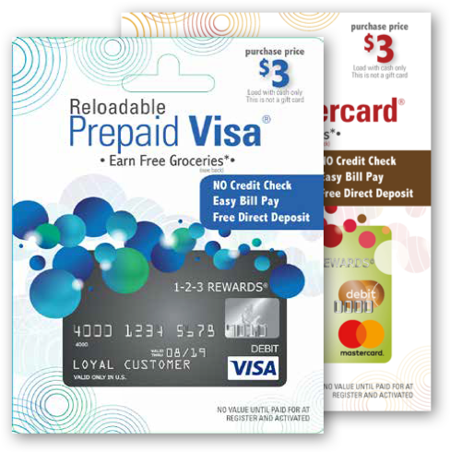
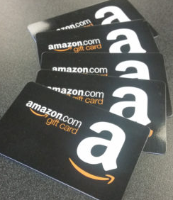
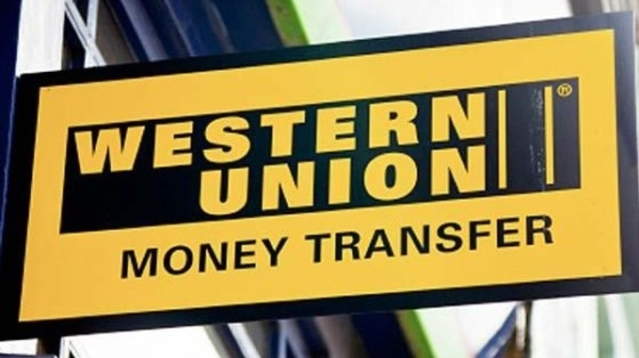
PAYMENTS CROOKS WANT
Cash
Wire transfers
Prepaid credit cards
Gift cards

Slide 10
IRS Scams
Notes:
Video link: https://www.youtube.com/watch?v=i4nCy6Xs6R8

Slide 11
The irs does not:
Call to demand immediate payment using a specific payment method such as a prepaid debit card, gift card or wire transfer. Generally, the IRS will first mail a bill to any taxpayer who owes taxes.
Demand that you pay taxes without the opportunity to question or appeal the amount they say you owe. You should also be advised of your rights as a taxpayer.
Threaten to bring in local police, immigration officers or other law-enforcement to have you arrested for not paying. The IRS also cannot revoke your driver’s license, business licenses, or immigration status. Threats like these are common tactics scam artists use to trick victims into buying into their schemes.

Slide 12
Social Security
The Social Security Administration will never threaten, scare, or pressure you to take an immediate action.
If you receive a call, text, or email that…
Threatens to suspend your SSN, even if they have part or all of your SSN
Warns of arrest or legal action
Demands or requests immediate payment
Requires payment by gift card, prepaid debit card, internet currency, or by mailing cash
Pressures you for personal information
Requests secrecy
Threatens to seize your bank account
Promises to increase your Social Security benefit…
IT IS A SCAM!!!!!

Slide 13
Medicare
Will not contact you for your Medicare number or other personal information unless you’ve given them permission in advance.
Will never call to sell you anything.
Will never visit you at your home.
Cannot enroll you over the phone unless you called first.

Slide 15
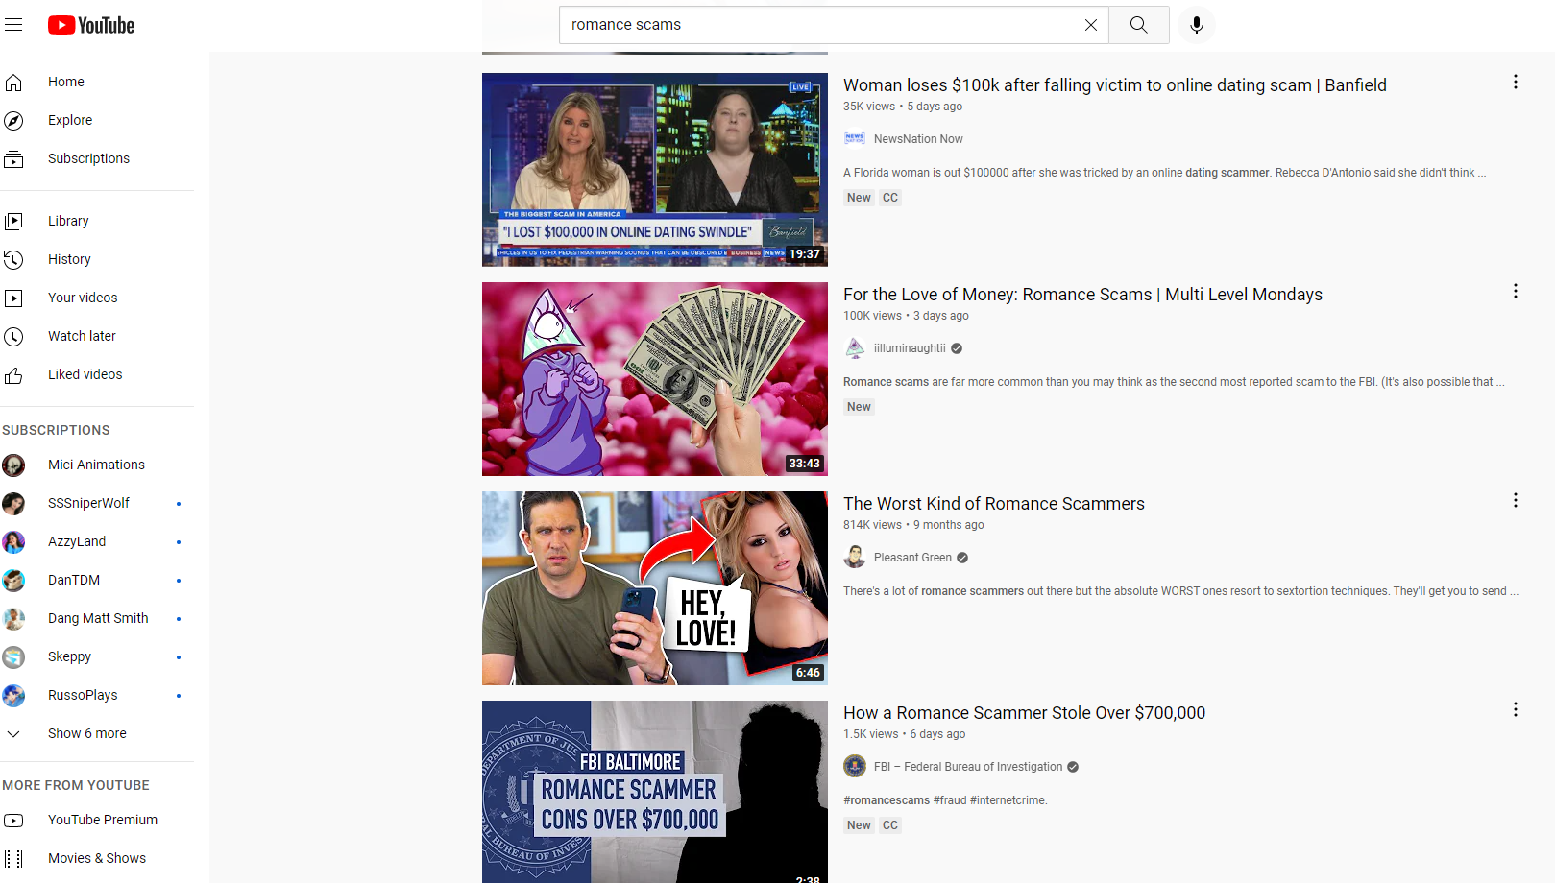
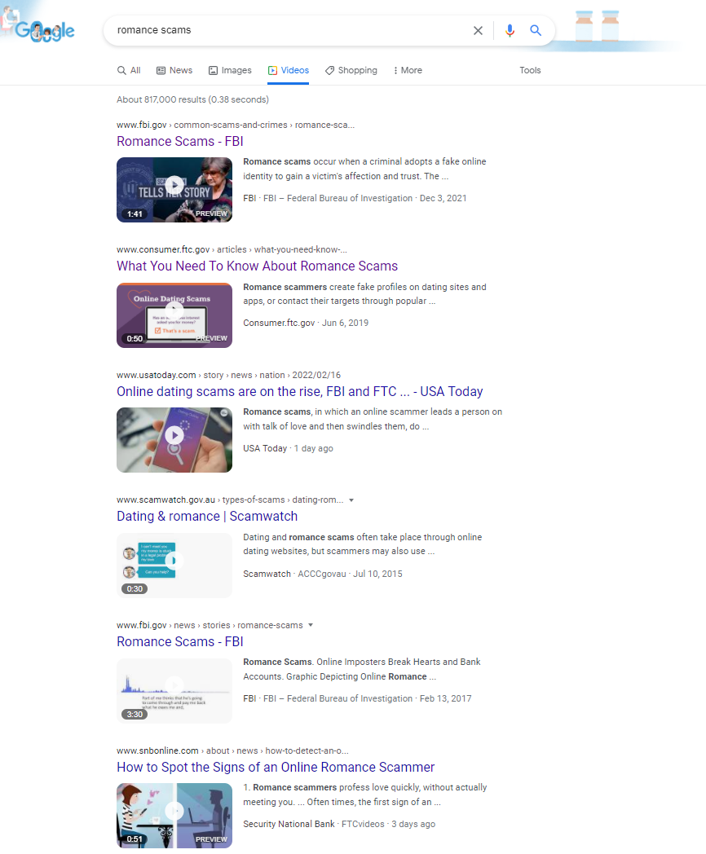
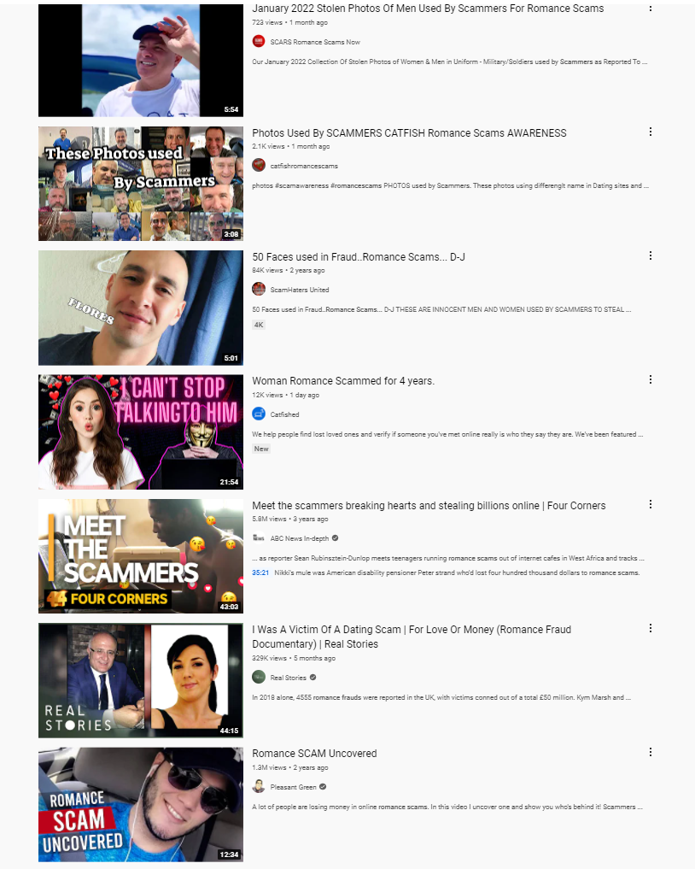
Romance Scams
Millions of people turn to online dating apps or social networking sites to meet someone. But instead of finding romance, many find a scammer trying to trick them into sending money.

Slide 16
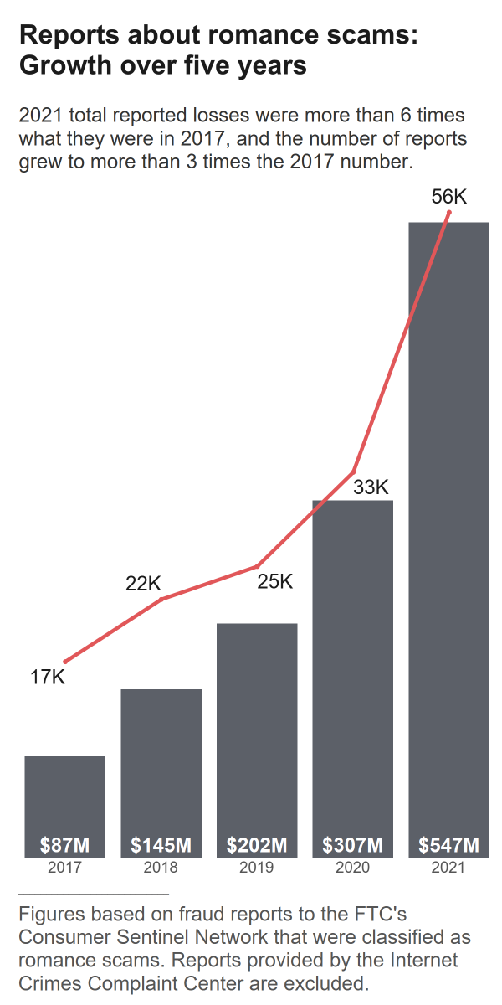
Romance Scams
The criminals who carry out romance scams are experts at what they do and will seem genuine, caring, and believable. Con artists are present on most dating and social media sites.
The scammer’s intention is to establish a relationship as quickly as possible, endear himself to the victim, and gain trust. Scammers may propose marriage and make plans to meet in person, but that will never happen. Eventually, they will ask for money.
fbi.gov/scams-and-safety/common-scams-and-crimes/romance-scams
consumer.ftc.gov/articles/what-you-need-know-about-romance-scams
aarp.org/money/scams-fraud/info-2019/romance.html

Slide 17
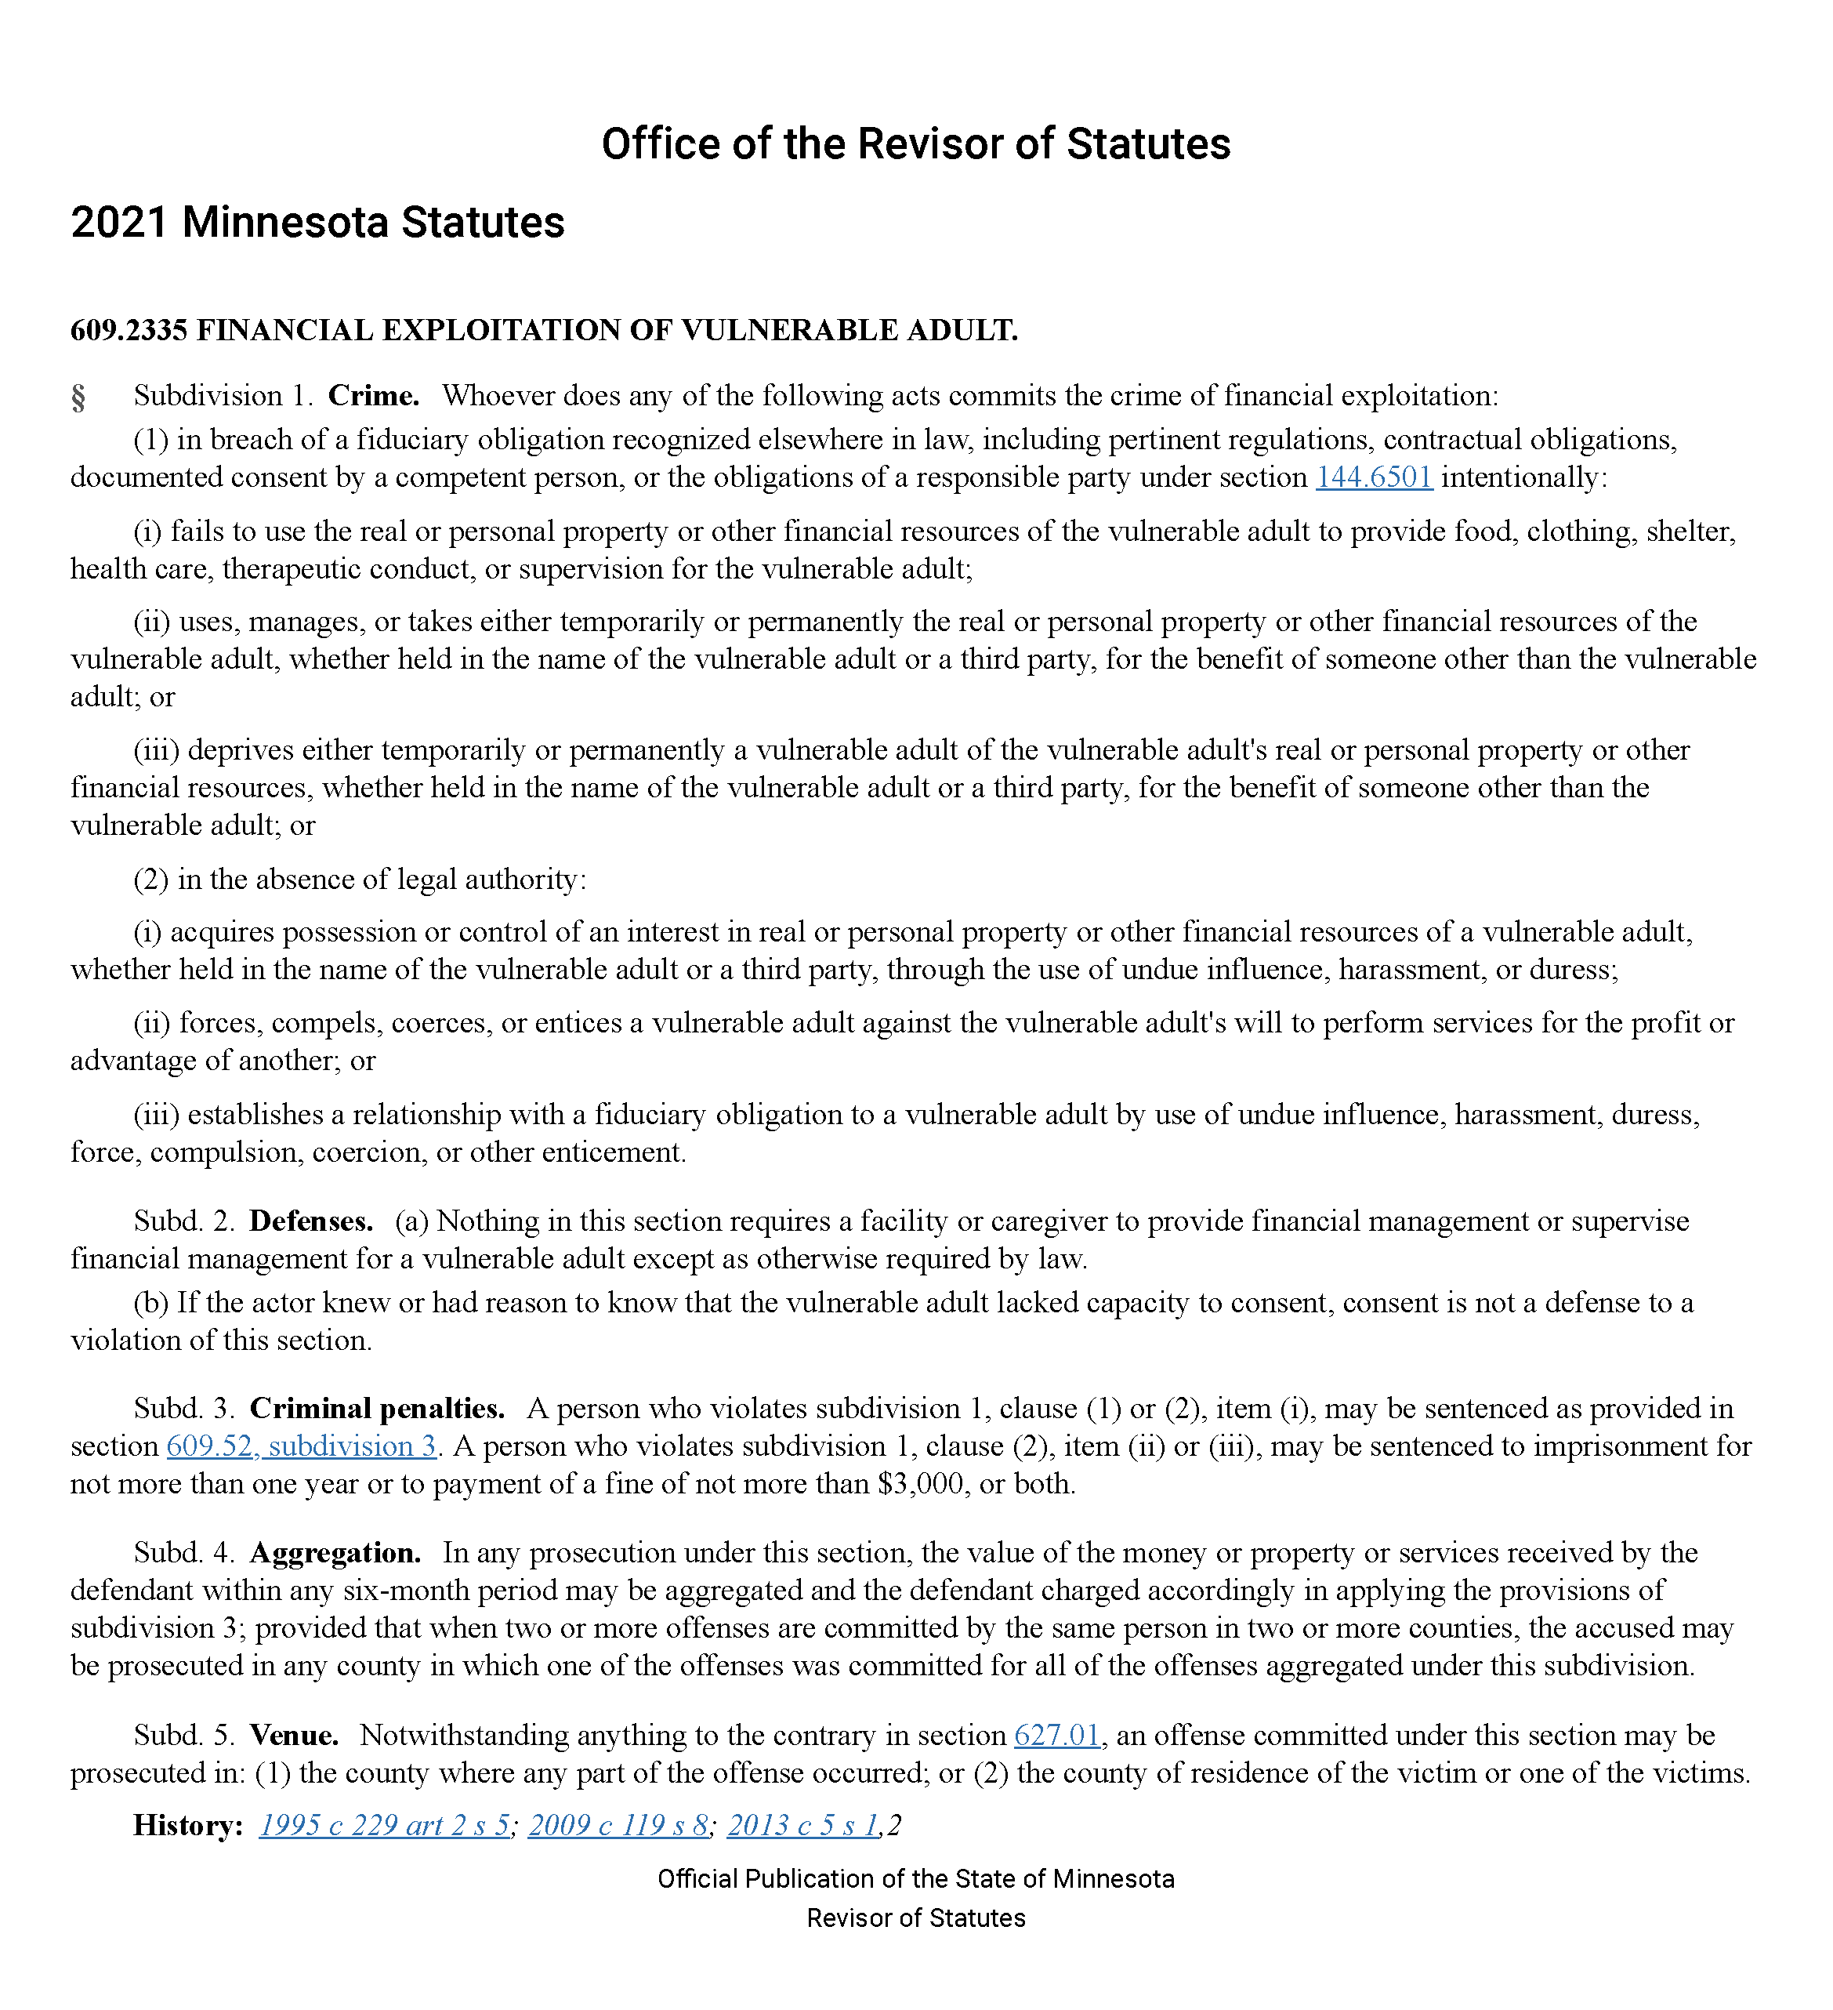
Minnesota law:
Financial Exploitation
Key elements of the law:
Intentional breach of a fiduciary obligation
Uses, manages, or takes financial resources for the benefit of someone other than the vulnerable adult
Acquires possession or control using undue influence, harassment, or duress

Slide 18
TIPS
You will never win a foreign lottery or sweepstakes.
Did you buy a ticket?
Don’t fall in love online without meeting someone face to face, and never send money to a love interest you have not met in person.
Romance scams are prolific and can result in significant financial loss.
Never purchase gift cards at the direction of someone you don’t know.
If you are being pressured to buy gift cards for someone you don’t know, you are being victimized. Cut off contact immediately.

Slide 19
Reporting to law enforcement
With so many kinds of scams and fraud, it’s hard to know where to report each type.
First, file a report with your local police department.
You may contact the state consumer protection office, which is the Minnesota Attorney General.
You can also report certain types of scams and fraud to federal enforcement agencies. Federal agencies usually can’t act on your behalf, but they can use complaints to record patterns of abuse. This helps them take action against a company or industry.
Contact these federal agencies based on the type of fraud:
Common scams and fraud: Federal Trade Commission (FTC): ftc.gov → *Do not call registration*
Report online crimes to FBI Internet Crime Complaint Center: ic3.gov
Identity theft or data breaches: IdentityTheft.gov
For more info on federal agencies and reporting: usa.gov/scams-and-frauds

Slide 20
RESOURCES
Minnesota Elder Justice Center
651-440-9300
www.elderjusticemn.org
Minnesota Adult Abuse Reporting Center (MAARC)
1-844-880-1574
Anoka County Attorney’s Office
763-324-5550
www.anokacounty.us

Slide 21
QUESTIONS?

