Slide 1
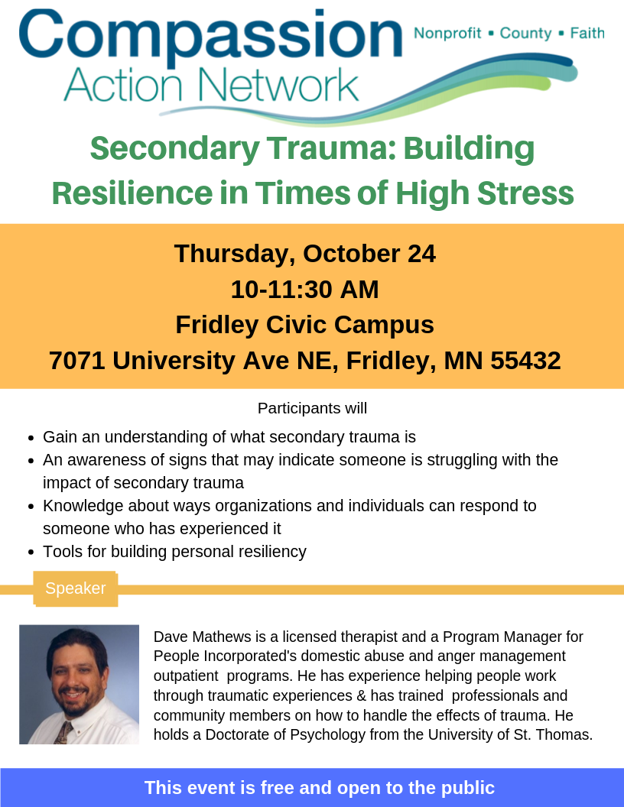
Welcome

Slide 2
Our Mission:
To foster collaborative opportunities to creatively address community needs in Anoka County.
If there is a topic you would like CAN to cover at the next event, please talk to us after or visit our website and send us a message
www.compassionactionnetworkanoka.org

Slide 3
Speaker
Dave Mathews
Dave Mathews is a licensed therapist and a Program Manager for People Incorporated's domestic abuse and anger management outpatient programs. He has experience helping people work through traumatic experiences & has trained professionals and community members on how to handle the effects of trauma. He holds a Doctorate of Psychology from the University of St. Thomas.
Additional Speaker
Renee Rosenberg, EMS Operations Supervisor, Allina Health Emergency Medical Services

Slide 4
Secondary Trauma: Building Resilience in Times of High Stress
David J Mathews, PsyD, LICSW
Therapist
People Incorporated,
Family Life Mental Health Center
763-746-5072
David.Mathews@peopleincorporated.org

Slide 5
introductions
My first name is
My tribe is
My land is
My water is
My mountains are
The other person responds with, “I hear (your first name).”

Slide 6
Please raise your hand …
How many of you have a friend or family member who has experienced a trauma, or you personally have experienced a trauma or high stress in your life?
How many of you currently work with or have some association with people in your life who have experienced trauma?
How many of you have worked for more than 1 year in a field or been helping others who have experienced some sort of trauma?
How many of you have worked for 5 or more years?
How many have worked for 10 or more years?
How many have worked 20 or more years?

Slide 7
What to gain from this session?
Better understanding of what “secondary trauma” is, how to identify it and the causes.
Increase understanding of “Trauma-Informed Care” and what it has to do with secondary trauma.
Self-Care strategies and tools for preventing and addressing my own experience of secondary trauma.
Other things or more specifically what you want to make sure we cover or address …?

Slide 8
Foundations
Self – Reflections
Professionally
Personally
Internally
Self – Awareness
Professionally
Personally
Internally
Perspectives

Slide 9
Self - Reflection
Understand what, where and how often I have been affected by trauma (my emotional reactions, motivations and intentions)
Honor:
What is SO for you – right now. What things am I thinking about right now, what other things am I thinking about and how does this affect my focus on secondary trauma?
My past emotional experiences as related to trauma: personally, professionally and internally (How many Adverse Childhood Experiences have I had? What is my ACE score?)
Today, right now, when I think about the words trauma, high stress, violence, abuse how do I feel and what do I think?
How might all this shape my thinking, behavior and ability to help adults, children, youth and their families who have experienced trauma or violence?

Slide 10
Self - Awareness
Understand what training and experiences I have had affect how I look at and think about trauma (how my work practice, professional experience, training shapes and has shaped my thinking)
Consider & Respect:
My personal and professional experience with terms such as trauma informed, trauma aware, trauma sensitive or trauma care.
My experience and training in becoming “trauma informed” or to provide “trauma informed care.”
The areas of being trauma informed that I feel most confident with and those concepts or parts I have some questions or challenges with.
The assumptions I have regarding those who have experienced trauma.
The strategies I use to address these assumptions.
My challenges (or limitations) related to dealing with others who have experienced violence or trauma.
My strengths I personally and professionally bring to working with those who have experienced trauma.
What my professional and/ or licensed body says about providing trauma informed care.
2 essential outcome questions to consider

Slide 11
2 Essential outcome Questions
Self - Awareness
What is my theory of change?
What is my preferred theoretical/ psychological approach with trauma experienced youth and parents and how does this contribute to my theory of change?
What therapeutic method/ strategy/ technique from this approach do I favor?
Why do I think this strategy works?

Slide 12
Dave’s Self - Awareness
Foundational Theories
Cognitive Behavioral Theory
Attachment/ Object Relations Theory
Feminist Theory – Oppression
Social Learning Theory
Positive Human Development Thinking
Theory of Change: Active Exploration, Awareness Building, Self-Acceptance, Empathy, Building Capacity or Agency and the Integration of Making Healthy Behavioral Choices within the Context and or Setting of Relationship

Slide 13
What Is the Intersection of …
Self - Awareness
… my approach and my theory of change that shapes my doing trauma informed care with those who are trauma experienced?

Slide 14
PERSPECTIVES

Slide 15
Perspectives
How many squares do I see?

Slide 16
Is the circle perfectly round?
Is this a perfect square?

Slide 17
A cube with a cube part missing? OR
A cube with a cube sticking out from the corner?

Slide 18
Is this a duck? OR
A rabbit?

Slide 19
Are these birds?
Or rabbits?

Slide 20
Perspectives Always Have a Story
Tell the story you see in the following pictures by arranging them in a way that makes sense to you

Slide 21
Arrange the Pictures to Tell a Story
&
#
@
*
+
%
Which one is the first one in your story?

Slide 22
Arrange the Pictures to Tell a Story
Which one is the last one in your story?

Slide 23
Arrange the Boxes to Tell a Story
Talk
ouch
Silence
Talk
Hushed
Talk
Quiet
No, don’t
Sorry
Listening
Sorry
Thanks
Hearing
warm
nice
Sorry
Listening
Which is the first and which is the last one in your story?

Slide 24
Perspectives Always Have a Story
Often after hearing someone’s story, we might ask:
Whose story is more correct?
Whose story is more accurate?
Is this person’s story more or less truthful than someone else’s or than mine?

Slide 25
Perspectives Always Have a Story
Better Questions
What differences and similarities do you see in the stories told?
When a context is provided, what happens to the stories?
When there are blanks, spaces or holes in the stories, what happens?
When words and phrases are used, how does this affect how you understand the story?
When the story is being shared not in one’s first language, how does this affect the story?
Why did the person tell the story using those words and phrases to tell it?
How might the person’s story be influenced by their cultural experience or perspective?

Slide 26
Perspective Highlights
We each have one
Context
Looking Deeper
Simultaneousness
Both – But Not Simultaneous
Self Imposed Agenda Trap
The Story is More Important than the “Facts”

Slide 27
The 3 essential Components of Trauma Informed care
Knowledge
Application
Self-Care
Knowledge
Application
Self-Care

Slide 28
3 essential Components of Trauma Informed care
Knowledge & Awareness
How the brain works
Developmental processes
Attachment
Physiology of stress
How trauma/ stress interacts or affects the brain, development, attachment
Community/ historical trauma
Adverse Childhood Experiences

Slide 29
3 essential Components of Trauma Informed care
Application
With children and youth
Conceptualize, assess and implement the information/ knowledge in my approach and work directly being done with the youth or child
Teaching skills of mindfulness
Teaching skills for self regulation: e.g. flocking
Teaching self-care strategies
With Adults
Conceptualize, assess and implement the information/ knowledge in my approach and work being done with the adult or parent
Teaching skills of mindfulness/ self-reflection
Teaching skills for self-regulation
Developing self-care strategies
Teaching ways to help their child
Role modeling Parenting skills: build empathy, understanding child’s perspective, considerations of a trauma experienced child/ youth, reframing behaviors, flocking, being with and assuring, etc

Slide 30
3 essential Components of Trauma Informed care
Professional Self-Care
Self-Reflection
Self-Awareness
Mindfulness
Self-Regulation
Self-Care

Slide 31
Trauma-Public Health Lens
What is it?
Define “it”
What does it include?
What causes it?
What is the etiology?
Where does it come from?
How do I prevent it and/ or address it?
Prevention methods
Tertiary – after the fact, to prevent it from happening again
Secondary – immediately after experience, for at risk identified individuals, while in the midst of the experience
Primary – prior to the experience and focused on promotion of what we want instead
Trauma informed care
Knowledge and understanding of the brain and how it is affected by stress or trauma
Application accordingly to children, youth, young adults and parents who have experienced it
Professional Self-Care - Understand how my own experience with trauma as a child or professional affects me

Slide 32
defining
Trauma
Stress
Secondary Traumatic Stress

Slide 33
Trauma - defined
“Trauma”
Any experience, perceived or real, of loss, transition or stress having a significant negative impact
Trauma is an emotional response to a terrible event like an accident, violence or natural disaster
Any adverse experience that results in a stress response
Any situation or event that results in feeling fear for one’s safety or security
An experienced action or event that is a “concussion” to one’s soul
When one’s world has been “rocked” at its core
Any event or experience, direct or indirect that induces a stress reaction
Types of Trauma
Acute
Chronic
Complex
Trauma Context Makes a Difference
“Natural” Occurrences and Events
Behaviors and Situations Caused by Another Person

Slide 34
Good stress – bad stress
Readiness
On my game
Alertness
Exercises the system and strengthens it or builds resistance to other types of stress
Good Stress
Controlled
Paced
Planned
Bad Stress
Random
Irregular
Uncontrolled
Hypervigilance
Dysregulation
Distractibility
Reduced hope for future
Risk of inappropriate and self defeating coping reactions

Slide 35
Trauma/ Stress - defined
STRESS
Good Stress
Planned
Controlled
Paced
Bad Stress
Random or Impending Uncertainty
Uncontrolled
Irregular, Static
Bad Stress = Trauma
Episodic - an event
Chronic - ongoing and multiple
Toxic - environmental

Slide 36
Secondary Trauma - defined
Trauma resulting from caring for, hearing about or witnessing the intense suffering of others.
Over time, the cumulative effect can result in an internalization of trauma, leading to compassion
fatigue or burnout.
-psychotherapt-center.com
Secondary traumatic stress refers to the presence of PTSD symptoms caused by at least one
exposure to traumatic material.
-APA
Secondary traumatic stress is a natural consequence of caring between two people, one
of whom has been initially traumatized and the other of whom is affected by the first traumatic
experience. Risk factors are empathy and exposure. Other risk factors are the care giver’s previous
trauma experiences and the extent to which they have been resolved.
-Figley, 1995
When someone shares their trauma with you …it becomes your trauma
Some other terms used at times interchangeably:
Compassion fatigue
Vicarious trauma
Burnout
Compassion satisfaction

Slide 37
Continuum of Traumatic Stress
Primary trauma (primary trauma victim)
Secondary trauma (Trauma experienced by family members, friends, first responders, helping professionals, etc.)
Compassion Fatigue (Trauma experienced by care-givers and helping professionals)
Secondary trauma
Burnout
Organizational trauma

Slide 38
Trauma – Cause & Contributing factors
Adverse Childhood Experiences (ACEs)
Multiple Factor Etiology
Exposure to events, situations or other people’s behaviors in the home, at school, work, in the community
Internal biological responses are the result not the cause of trauma
Helps to give explanation to behavior (not an excuse for it)
Often we ask, What’s wrong with this person vs. What happened to this person?

Slide 39
Common Immediate Trauma/ Stress Reactions
EMOTIONAL
Numbness and detachment
Anxiety, severe fear
Guilt, shame
Mania
Anger
Sadness
Helplessness
Disassociation (feeling outside one’s body)
Disorientation
Denial
PHYSICAL
Nausea/gastrointestinal distress
Sweating or shivering
Faintness
Muscle tremors, uncontrollable shaking
Elevated heartbeat, respiration, and blood pressure
Extreme fatigue, exhaustion
Greater startle response
Depersonalization

Slide 40
Common Delayed Trauma/ Stress Reactions
EMOTIONAL
Irritability and/or hostility
Depression
Mood swings, instability
Anxiety (e.g. phobia, generalized)
Fear of trauma recurrence
Grief reactions
Shame
Fragility/vulnerability
Emotional detachment
PHYSICAL
Sleep disturbances, nightmares
Somatization (increased focus on and worry about body aches and pains)
Appetite and digestive changes
Lowered immune response
Persistent fatigue
Elevated cortisol levels (fight or flight hormone)
Hyper arousal
Long-term health effects including heart, liver, autoimmune disease

Slide 41
Brain Physiology
All of us are born with a brain containing billions upon billions of brain cells
As we get older brain cells connect with other brain cells
Connections of brain cells are nurtured or enhanced through experience (stimulation through intake by way of our senses) and enter our experience through at least one of our senses
The more neural connections made the more pathways of thinking that get created
The actual full size of our brain peaks out about 4 years old, however the brain cells continue to make connections
Brain cells continue to make these connections until we are about 25 years old

Slide 42
Brain Development
Reasoning
Decision Making
Neo-Cortex
Emotions
Instincts
Limbic
Movement
Balance
Diencephalon
Sensory Input
Internal System Control
Brainstem

Slide 43
Instinctual SURVIVAL/ Stress responses – 5 F’s
FIGHT – react with aggression
FLIGHT – leave, exit, hide, get away
FREEZE – immobilization
FOLD – give up
FLOCK – connect, the only stress response that can result in the release of oxytocin

Slide 44
Stress hormones
Adrenaline and Cortisol are the hormones responsible for how we react during trauma (fight, flight, freeze, fold, flock)
Normally, stress hormones like Adrenaline and Cortisol are temporarily released into the body at high levels – and last 15 to 20 minutes when the stress has ended
Traumatized individuals often have ongoing elevated stress hormones, resulting in…
Memory and attention problems
Irritability
Sleep disorders
Many long-term health problems

Slide 45
Neuro-Transmitter Active With Trauma
Cortisol, a hormone that the adrenal cortex produces in response to stress, prepares the body to react to potentially dangerous situations. It increases the level of sugar in the bloodstream and the brain's use of glucose, while curbing non-essential bodily functions, such as those that support reproduction and growth. Cortisol also suppresses the immune system and decreases the release of digestive secretions.

Slide 46
More on Cortisol
Cortisol plays an important role in protecting the body from imminently threatening situations by reallocating the body's resources to functions related to fighting against or fleeing from a threat. When the stressful situation ends, the body stops releasing the hormone. In the modern world, most stressful events do not involve physical danger. Experiencing pressure to perform at work or school, or juggling responsibilities at home, may last for an extended period of time. In response, the body keeps producing cortisol and its levels remain high rather than returning to normal. This continual release of cortisol has been shown to have negative health effects, such as anxiety, digestive troubles, heart disease and weight gain. See also ACEs.

Slide 47
Oxytocin
Attachment Hormone
FLIP SIDE of Stress Hormone (Cortisol)
Sense of attachment, connectedness, belonging, calmness, peace, safety, calm and security
Quick acting and short lived
Most often emitted when some sort of connection is made
Safe, secure, gentle, appropriate touch
Eye contact
Physical space presence of someone else who is not dysregulating
Imagery of connectedness with someone
A pet connection
Prayer, meditation or sense of connectedness with universe
Can be a positive tool used and practiced
Often happens as a result of the limbic system stress reaction - flocking
Care must be taken in who is being connected with, for it to be positively useful

Slide 48
During trauma/ Stress…
Reduced activity by way of the Corpus Callosum (the bridging connection of the left and right brain)
Right brain takes over, left brain shuts down
Without left brain activated, we cannot…
Organize our experiences into logical time sequence
Put feelings/perceptions into words (Broca’s Area shuts down)
Understand cause/effect
Understand long-term consequences of our actions
Create coherent plans for the future

Slide 49
EXAMPLE of Stress Reactions
Baby Still Face

Slide 50
Trauma and brain response
Only fragments of memories are stored—full context is not processed
No analytical decision-making
Emotional responses to triggers or stimuli do not necessarily match (overreaction, under-reaction)
If we’re using survival brain most often, we’re not developing frontal lobe capabilities
Elevated hormone levels over long periods of time have negative health effects

Slide 51
Behavioral implications
Hyper-vigilance—hard to calm down, overly aware of surroundings
Routinized defense—prepared to fight, quick to anger/defense
Externally in tune with environment, strong survival skills
Less in tune with the self/needs/body clues/impact on others
Quick to make assumptions about others
See the world as adversarial vs. something you can engage with

Slide 52
Behavioral implications
Lack of predictability in behavior
Have to be “prepared” regardless
Cannot stay organized, focused, paced, predictable
Self-loathing, self-blame, shame
“what is wrong with me?” vs “what is happening to me?”
Tendency to reenact painful episodes (tethered to the past)
Creation of chaos (difficult in service environments)
Quick criticism, resolute judgement
Resentment, bitterness, unresolved losses

Slide 53
Long term implications
When individuals who grew up with high levels of stress accumulation or are exposed to stress over a long period of time do not receive the supports they need to balance this condition, then they transmit this problem onto future generations—process starts again
We all pay for this lack of investment in early intervention (health care, prisons, treatment centers, businesses etc.)
Hundreds of billions of dollars annually to support strategies that do not intervene early enough

Slide 54
Adverse childhood experiences study (aces)
Examines the health and social effects of ACEs throughout the lifespan
Studied among 17,421 members of the Kaiser Health Plan in San Diego County (1995/1997)

Slide 55
ACEs categories
Physical abuse
Emotional abuse
Sexual abuse
Someone with alcohol/drug abuse problem in the home
Incarcerated family member
Someone with chronic and untreated mental illness
Witnessed your parent/ mother treated violently
Divorce/ Separation
Emotional neglect
Physical neglect

Slide 56
ACEs Mortality Rate
Anyone with an ACEs score of 6 or higher (without any intervention or help or assistance) likely has a 20 year shortened life expectancy.
There are three main mechanisms that lead to this shortening of life expectancy:
Coping skills & Emotional/Cognitive Impairments
Bio Medical
Epigenetics

Slide 57
Poor Coping Skills & Emotional/ Cognitive Impairments
Unhealthy, self destructive behavior choices
Alcoholism
Smoking
Substance use
Heroin, opioid and methamphetamine use
Suicide attempt (4600% more likely to attempt than a person with an ACE score of 0)
Emphysema
Depression and other Mental Health Issues
Liver disease
Obesity
Major social malfunction (e.g. prison)

Slide 58
Bio Medical
Higher the ACE score more likelihood of increasing immune system suppression
Cancers
Multiple sclerosis
Lupus
Rheumatoid Arthritis
Other Auto Immune Diseases
Other health related issues:

Slide 59
epigenetics
The study of biological mechanisms that will switch genes on and off.
Certain circumstances in life (environmental) can cause genes to be silenced or to be expressed over time
If a person’s environment is filled with trauma, there will be toxic stress over a long period of time
They develop a hair-trigger response to trauma, have difficulty recovering from trauma, and can pass these altered genes on to their children

Slide 60
ACEs - Missing Areas or areas of More Needed Consideration
“Resiliency” initially not looked at or considered
Only 10 identified and currently studied, other possible adverse childhood experiences which have not yet been fully researched:
Community Violence
Bullying
Historical Violence
Social Media Violence
Wars & Genocide
Refugee Experience
Racism
Oppression Experience
Terrorism
Other vicarious experiences of violence
Current research is not generalizable to non-majority community members
A lack of providing practical and usable strategies once ACE score is identified

Slide 61
Attachment Implications
Secure
Insecure
Avoidant
Ambivalent
Disorganized
Note: It is important to understand the family's culture when you are observing attachment. A secure attachment in one culture may look like an insecure attachment in another culture

Slide 62
Community & Historical Trauma
History of the identified community
Trauma history of the community
How coping behaviors integrated into common experience and passing on of coping behaviors to next generations
Racism and oppression experience
Proverbs and cultural norms, values, stories

Slide 63
Post Traumatic Growth
Characteristics of PTG:
1. Appreciation of life – Overall out look is more positive and optimistic than before the trauma. 2. Relationships with others – Are more important, meaningful and cherished even more deeply. I also realize I am not alone. 3. New possibilities in life – I am experiencing life and day to day choices differently with more optimism. 4. Personal strength – I can get through anything now. 5. Spiritual change/ connection
Source: Richard Tedeschi, PhD, and Lawrence Calhoun, PhD, Journal of Traumatic Stress, 1996

Slide 64
Secondary Trauma - defined
Trauma resulting from caring for, hearing about or witnessing the intense suffering of others.
Over time, the cumulative effect can result in an internalization of trauma, leading to compassion
fatigue or burnout.
-psychotherapt-center.com
Secondary traumatic stress refers to the presence of PTSD symptoms caused by at least one
exposure to traumatic material.
-APA
Secondary traumatic stress is a natural consequence of caring between two people, one
of whom has been initially traumatized and the other of whom is affected by the first traumatic
experience. Risk factors are empathy and exposure. Other risk factors are the care giver’s previous
trauma experiences and the extent to which they have been resolved.
-Figley, 1995
When someone shares their trauma with you …it becomes your trauma
Some other terms used at times interchangeably:
Compassion fatigue
Vicarious trauma
Burnout
Compassion satisfaction

Slide 65
Things for me to do – Prevent &/or address
Identify it – Self Awareness and Self-Reflection
My own ACE score
How do the experiences, learning and thinking affect how I do my job
EPIC Moments
Mindfulness Strategies
Self-Care Plan and Strategies
Regulation Planning
Set up a “Trauma Spotter”
Consider any Organizational Secondary Traumatic Stress

Slide 66
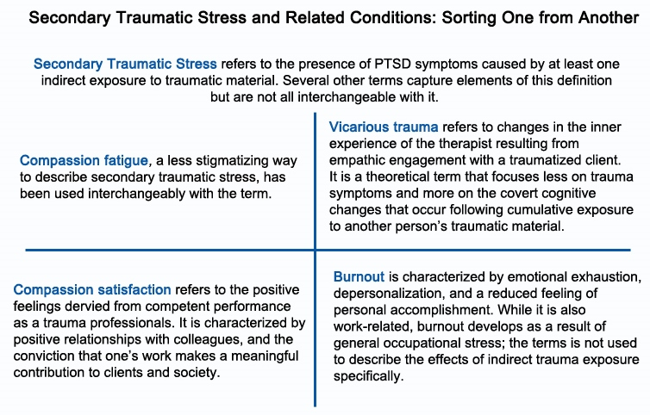

Slide 67
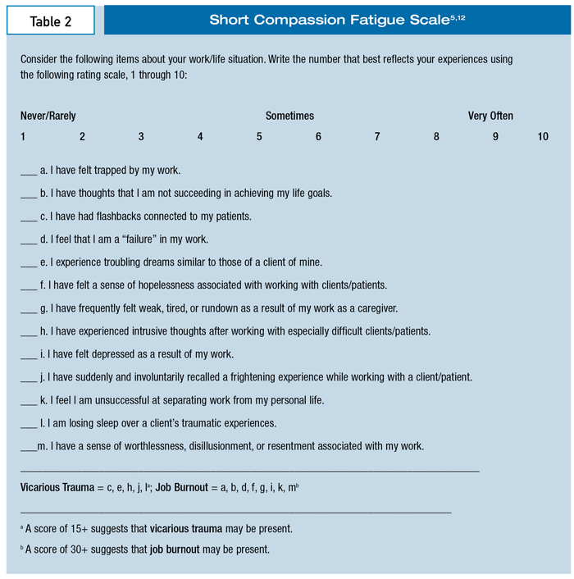
Identify – Self-Aware/ Reflect

Slide 68
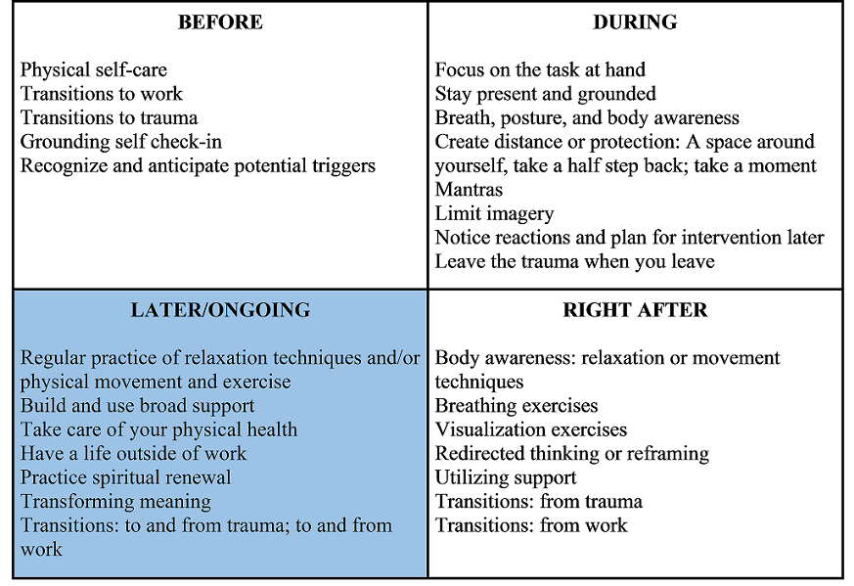
Somethings to do ….

Slide 69
EPIC Moments Strategy
Energy Passion Inspiration Connections
Energy
Passion
Inspiration
Connections

Slide 70
A Story behind the Passion
The Hennepin County Domestic Violence Fatality Review Team 2004
Brief Purpose, background and composition of the HC DVFRT (http://www.amatteroflifeanddeath.org/ )
Reviewing a homicide that happened in 2001
Chronology done on the victim and the offender/ killer
Took me back to an experience in 1988 when working at the Wilder Community Assistance Program
"Battered" A Video Documentary by Lee Grant
The HC FRT looked into this man’s experience between being 11 and when he killed his former girlfriend
The Summer of 2019
So what have we learned and implemented to address Childhood Trauma since then in our systems ? Has much changed in how we do things, now that so many claim to be “trauma informed?”

Slide 71
Some Further Resources
Trauma Stewardship: An Everyday Guide to Caring for Self While Caring for Others by Laura van Dernoot Lipsky and Connie Burk
The Body Keeps the Score: Brain, Mind, and Body in the Healing of Trauma by Bessel van der Kolk M.D
ACEsConnection.com
Echoparenting.org
Dr. Vincent Felitti Reflections on the Adverse Childhood Experiences (ACE) Study, 2016, YouTube.com https://www.youtube.com/watch?v=-ns8ko9-ljU
Restorative Parenting, training happening on Thursday, December, 2019 9-4 PM go to the www.Peopleincorporated.org website to register

Slide 72
What DID I gain from this session?
Better understanding of what “secondary trauma” is, how to identify it and the causes.
Increase understanding of “Trauma-Informed Care” and what it has to do with secondary trauma.
Self-Care strategies and tools for preventing and addressing my own experience of secondary trauma.
Other things or more specifically what you want to make sure we cover or address …?

Slide 73
Closing
Final questions
One Take Away from this session
Closing Words
Thanks for your attention and participation!!
David J Mathews, PsyD, LICSW
Therapist
People Incorporated,
Family Life Mental Health Center
763-746-5072
David.Mathews@peopleincorporated.org

