Slide 1

CAN Connect Presents:
Religious Differences, Common Bonds

Slide 2

Our Mission:
To foster collaborative opportunities to creatively address community needs in Anoka County.
If there is a topic you would like CAN to cover at the next event, please talk to us after or visit our website and send us a message
www.compassionactionnetwork.org

Slide 3
Speakers:
John Emery, Speaker for the Islamic Resource Group
John Emery completed intensive study of the Arabic language in the US Army. After his honorable discharge from the US Army, John completed his B.A. in Global Studies at the University of Minnesota. John is currently a speaker for the Islamic Resource Group, a Minnesota nonprofit dedicated to building bridges of understanding between Minnesota Muslims and the broader
Minnesota community. As an American convert to Islam, John is actively engaged in promoting peace and understanding across faith communities.
Asma Mohammed Nizami, Program Manager Reviving The Islamic Sisterhood for Empowerment (RISE)
Asma Mohammed is a professional from Minneapolis with a background in education, political organizing, and nonprofit operations. Asma directs civic engagement efforts that amplify the voices of Muslim women. Her other current projects include serving on the board for Break the Silence MN, a group focused on giving voice to survivors of sexual violence, and she is also a fellow at the American Muslim Civic Leadership Institute.
Kausar Hussain, Board President, Islamic Center of Minnesota
Kausar Hussain is the current President of the board of the Islamic Center of Minnesota. She is the first female President in its 47 years of history of Islamic Center of Minnesota. Kausar has lived in the twin cities for 30 years with her family. Professionally, she is a business owner and serves on multiple boards and volunteers with various organizations.

Slide 4


Islamic Resource Group
www.irgMN.org
© 2017 Islamic Resource Group (IRG) – All Rights Reserved
IRG materials may not be reproduced or stored in a retrieval system, and presentations may not be recorded without prior written permission of the IRG Board of Directors.

Slide 5
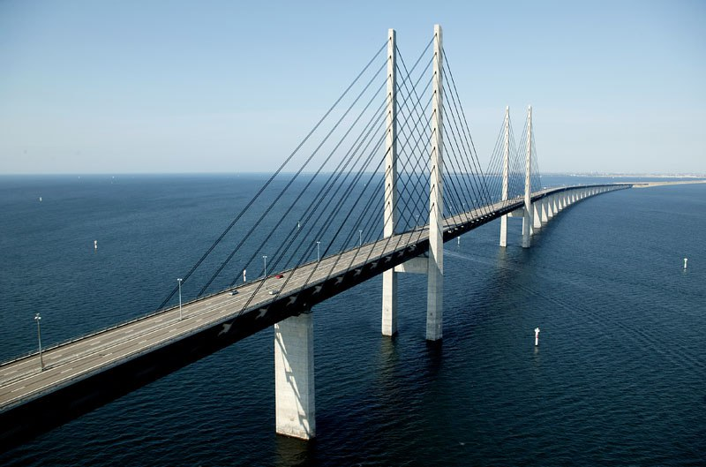
Islamic Resource Group
Wants to build bridges of understanding between Minnesota Muslims and the broader Minnesota community through education.
We believe that a deeper understanding of different religions and cultures contributes to peace and harmony in the world.
Notes:
Today, I am here to give you an overview of what it means to be a Muslim. Much of the information may be review for you, and a chance for your teacher to see how much you have learned. I may ask you questions throughout the presentation to find out what you know, and encourage you to ask any questions you may have about Islam and Muslims.

Slide 6
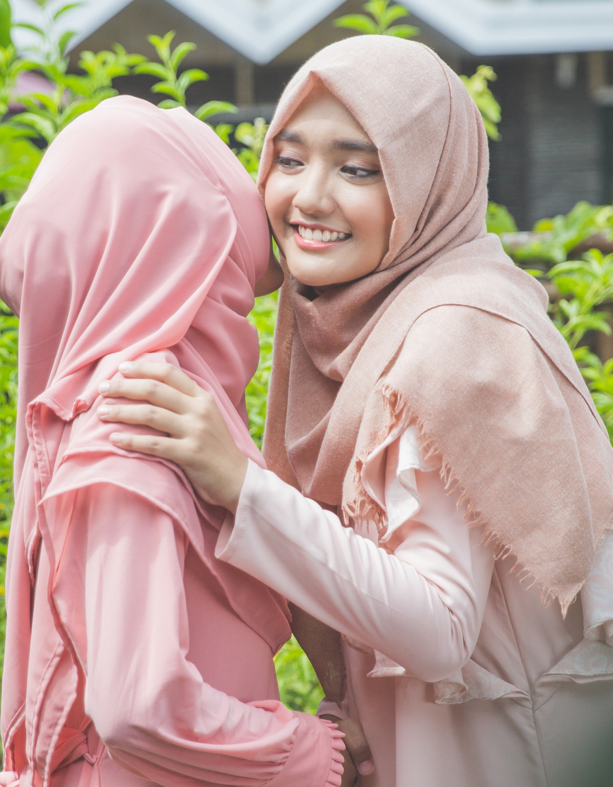
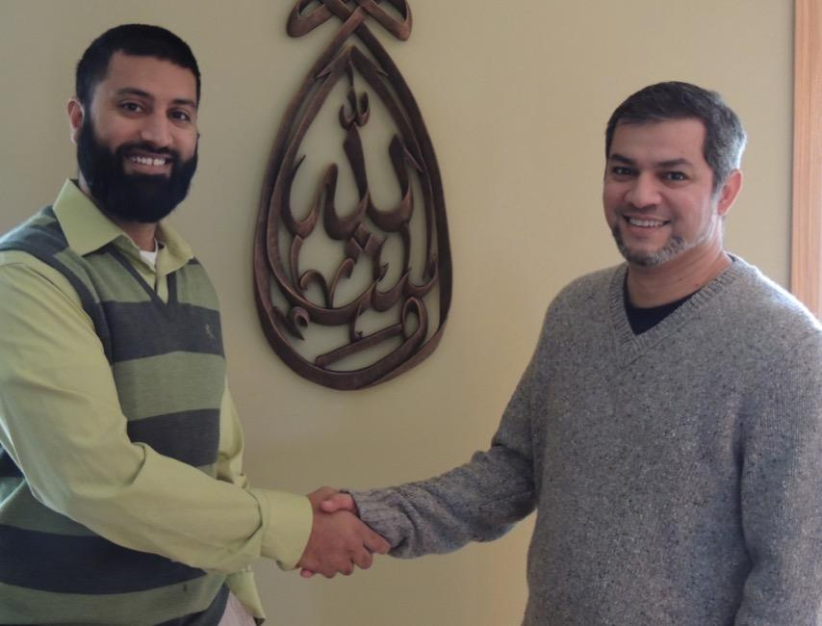
As-salamu alaykum
“Peace be upon you.”
Wa alaykum as-salam
“And peace be upon you, too.”
Notes:
Muslims all over the world, from Morocco to Indonesia, use the same greeting when they want to say “hello” or “good-bye” to each other.
Ask: What language is this greeting in? Arabic
The greeting is “As-salamu alaykum”, which literally means “Peace be upon you.“
The response to this greeting is “Wa alaykum as-salam”, which means “And may peace be upon you, too. “
Tip: It's a great icebreaker to have students repeat the greeting in Arabic after you have said it. You may also suggest that the students try the greeting next time they meet someone who is a Muslim.

Slide 7
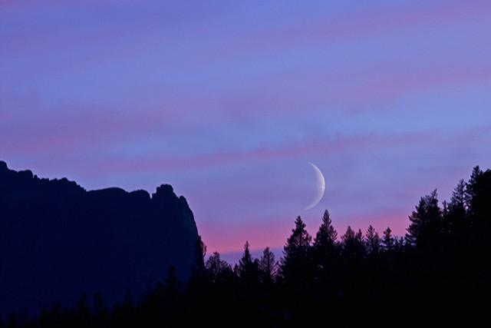
Islam
Peace through compliance with God’s will
Arabic root meaning ‘peace’
Islam is a way of life.
Notes:
Tip: Ask: “Does anyone know the meaning of the word Islam?” Although the students may have studied the section on Islam for weeks before your presentation, few may remember the answer to this question. “Is it a country, city, language?
The term Islam is derived from the Arabic root “s-l-m”, which generates interrelated words, such as “peace”, “submission”, and “obedience.”
Peace through submission to God implies that one attains peace by following God’s guidance and commandments.
Tip: Cite common every day examples of how Muslims submit to God, such as through wearing modest clothing and diet.
Notice that the name Islam is not tied to a particular person who taught the religion, but rather represents an idea that followers of Islam embrace.
Islam is viewed by its followers as a continuation and confirmation of the original monotheistic message.
Islam is commonly described as a religion but it is more accurately a “way of life” that addresses important aspects of our life such as clothing, diet, family life, as well as social, economic, and political aspects.
The word “Islamic” is an adjective used to describe non-human nouns, such as Islamic art or Islamic architecture. It cannot be used to describe a follower of Islam.
Ask: “What do you call someone who follows the religion of Islam?”

Slide 8
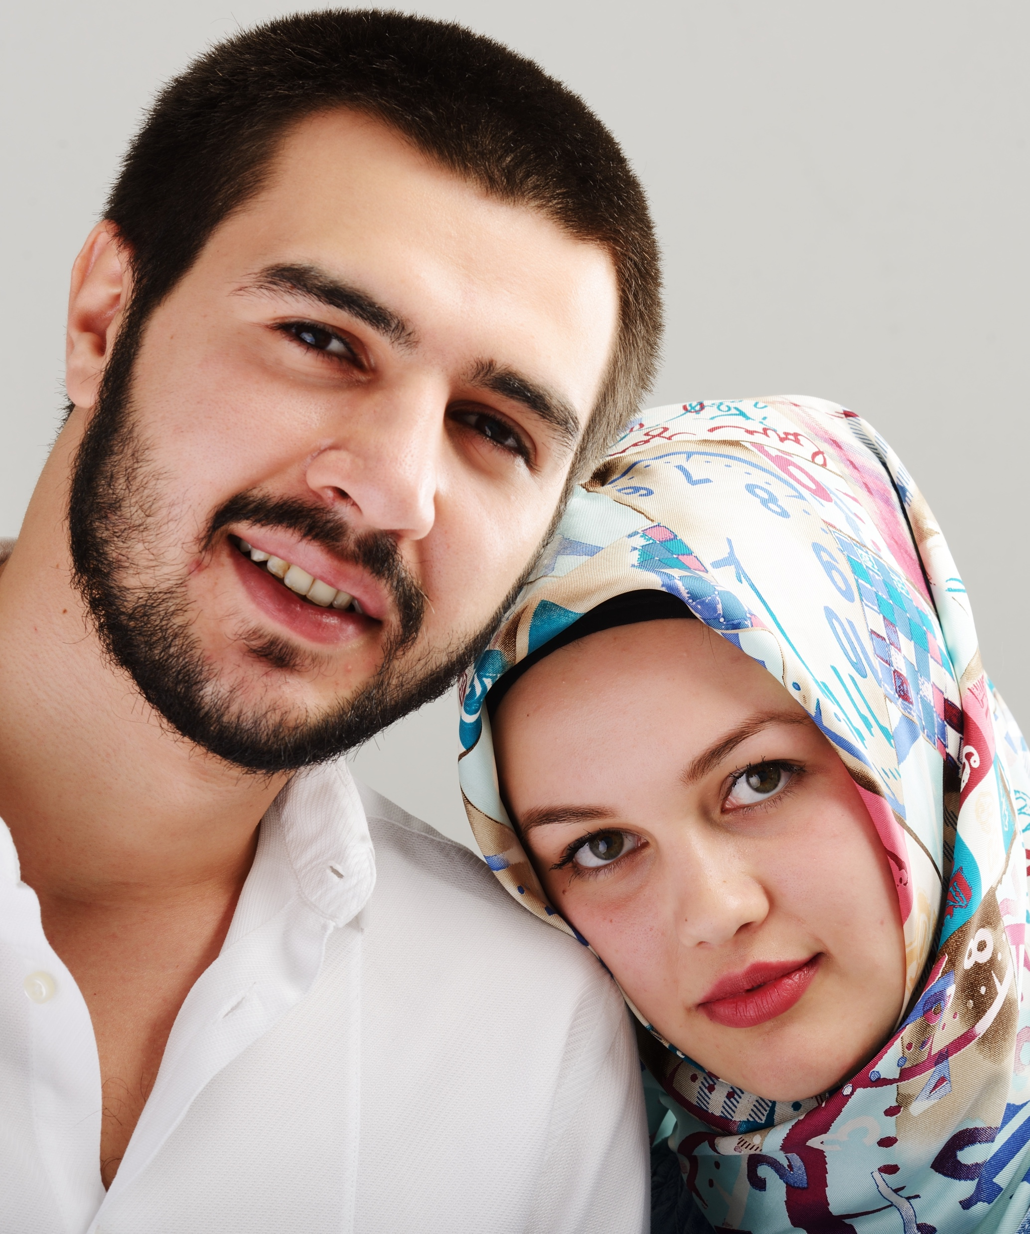
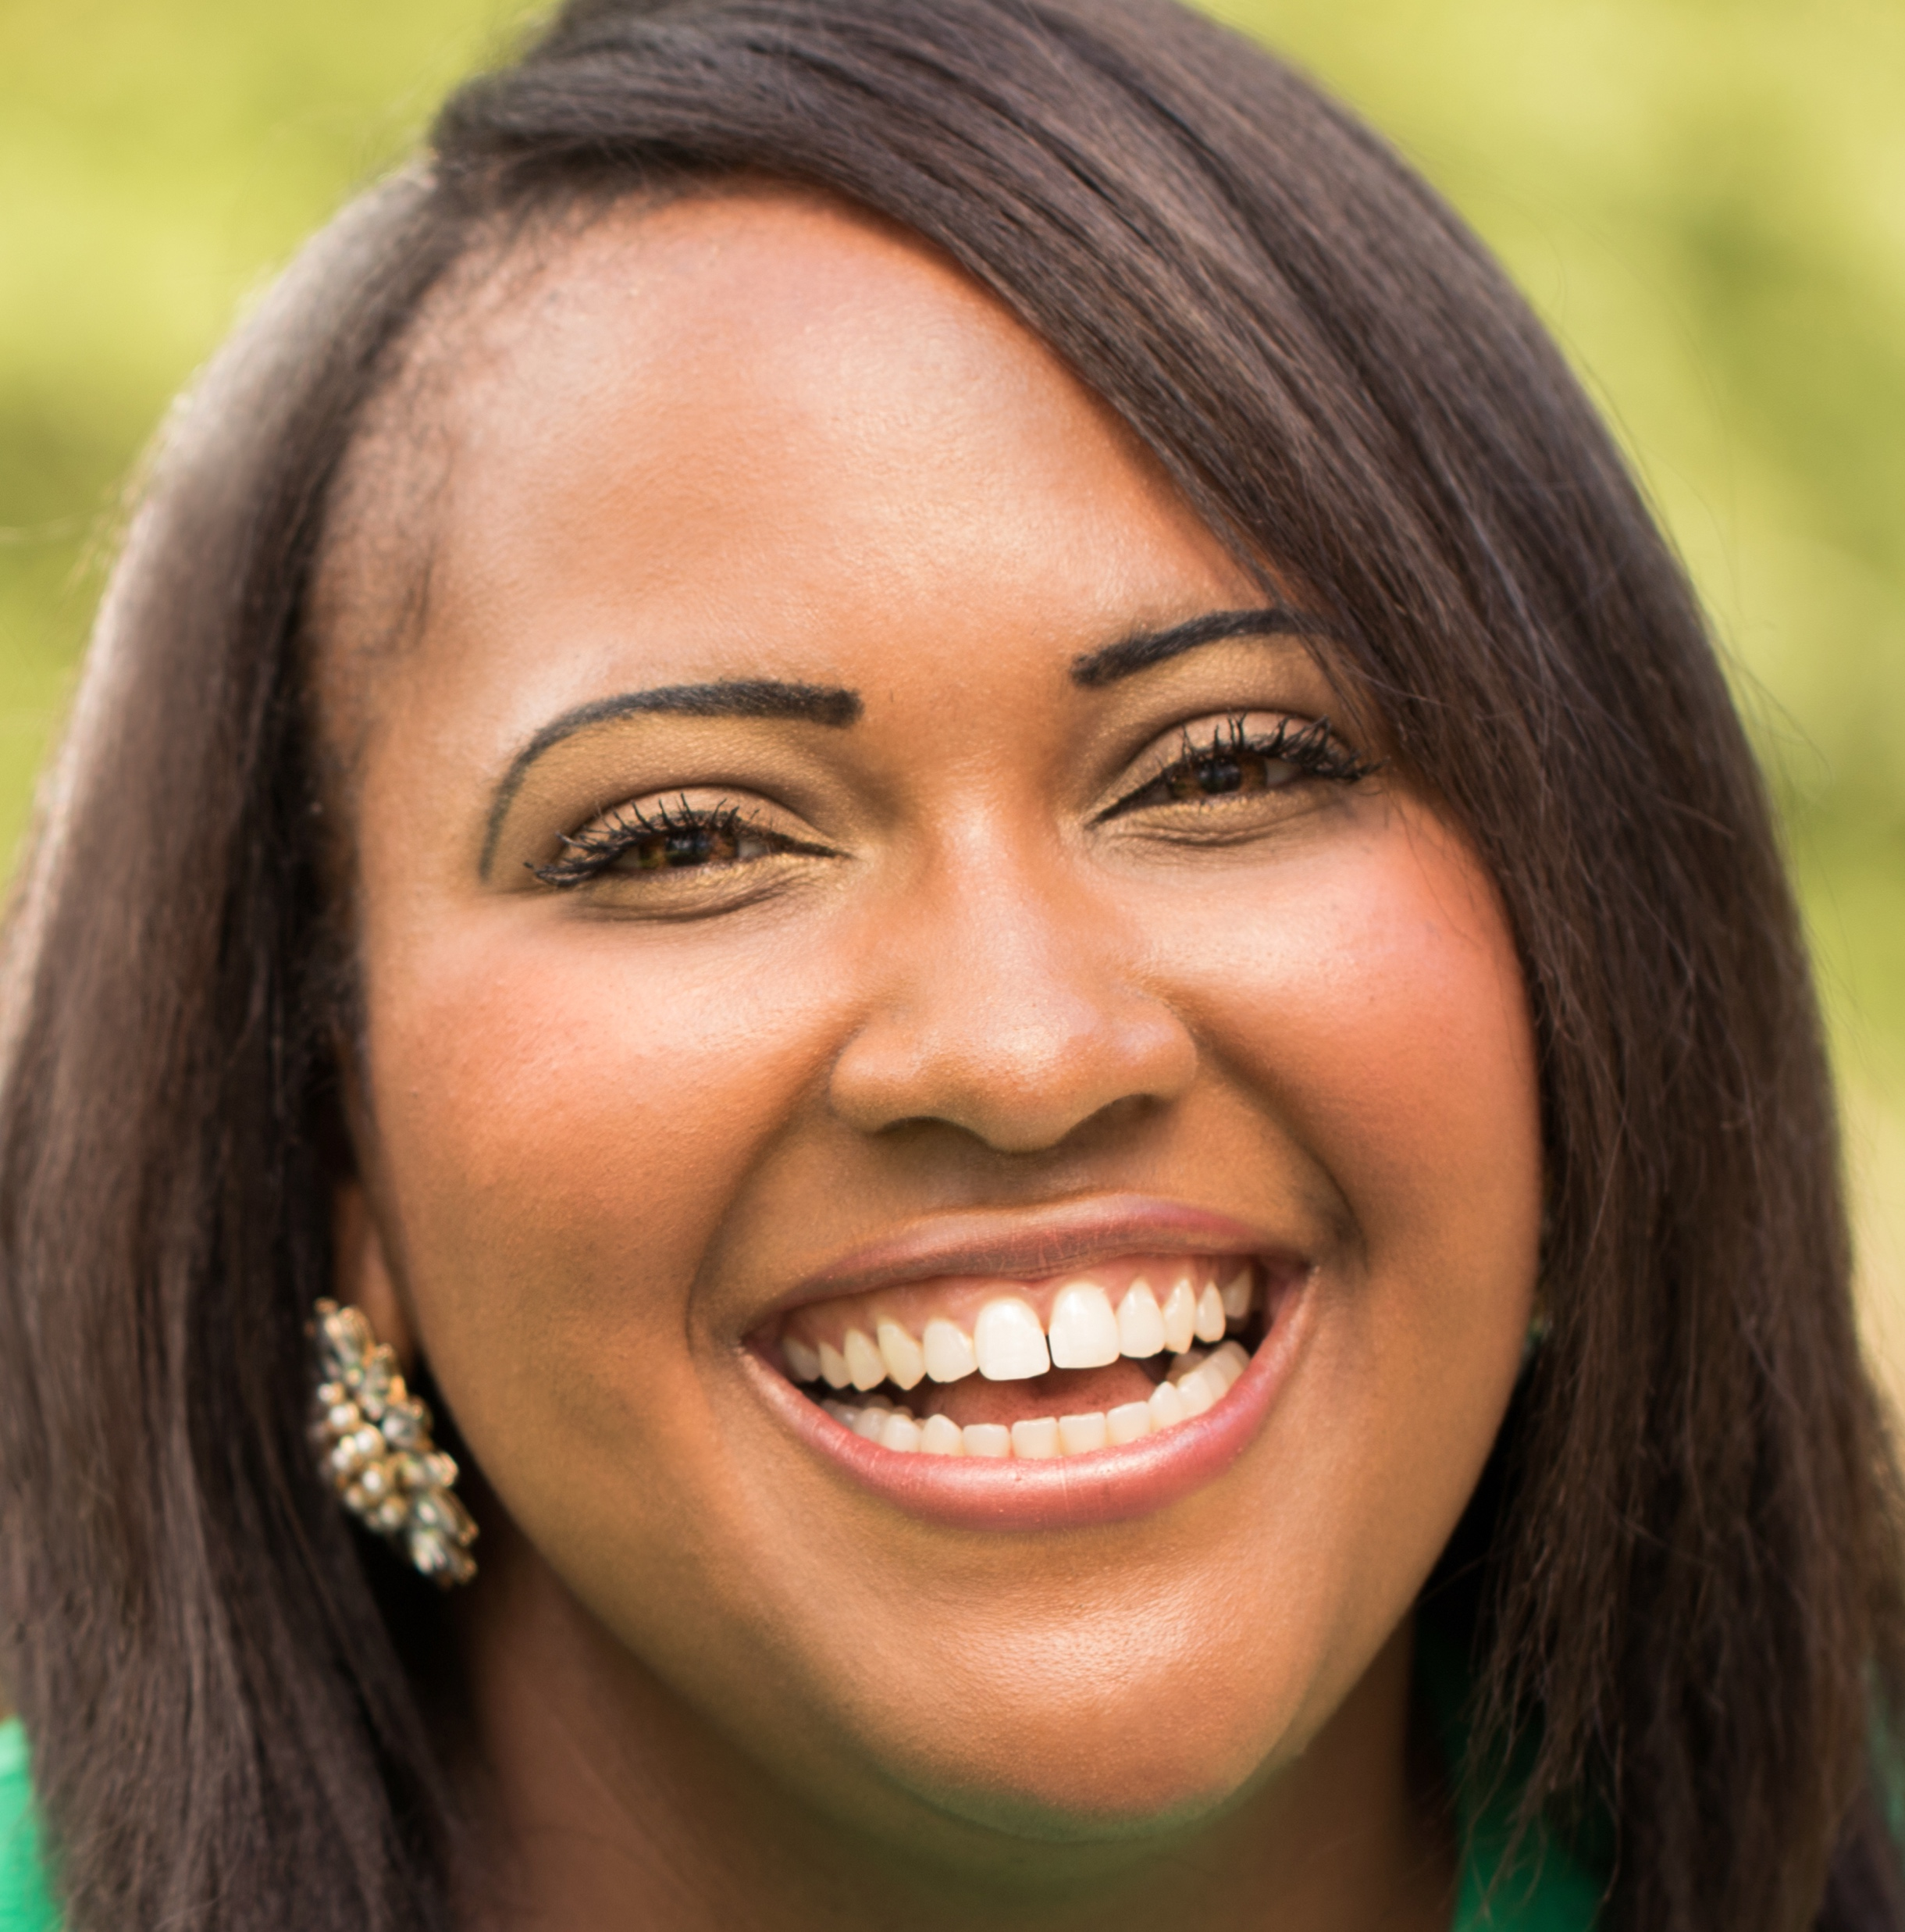
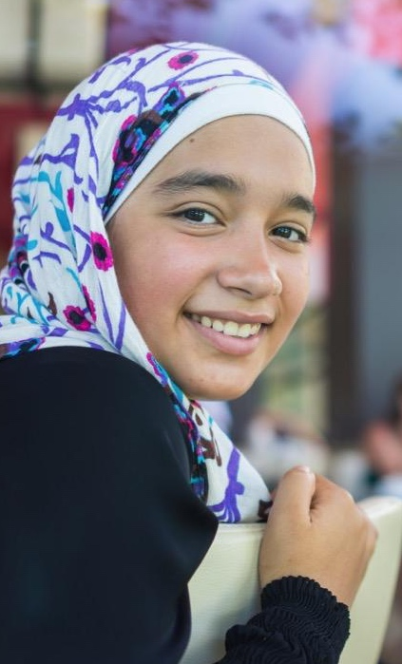
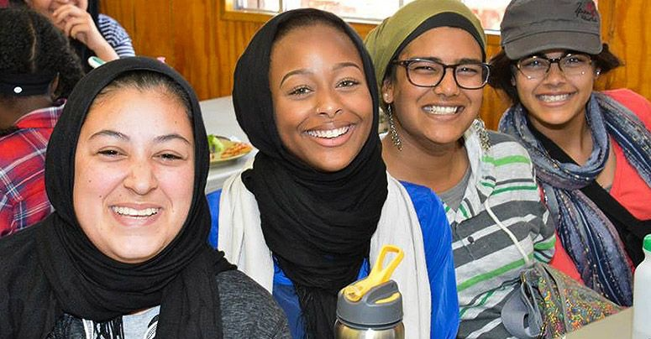

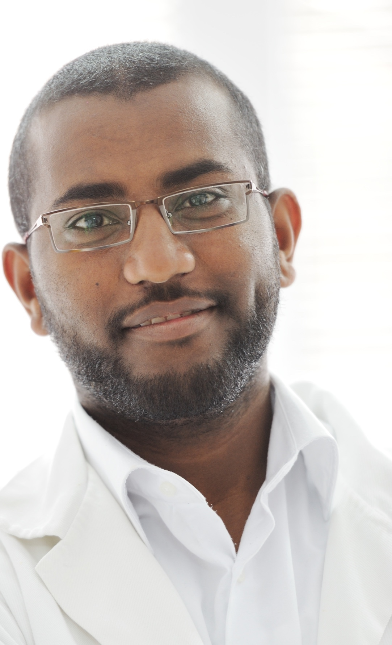
Muslim
“One who seeks peace by complying with God’s will”
Notes:
Tip: Ask: What do you call someone who follows Islam?
A person who follows Islam is called a Muslim, or literally one who "submits to God."
Many people are confused by the words Islam and Muslim, probably because they begin with two different letters. The key to both is the Arabic root s-l-m, which occurs in both words.
The correct pronunciation of the word “Muslim” is with a soft “s”, unlike the word “muslin”, the cloth. Tip: You may have the students repeat the word after you.
More commonly, a Muslim is defined as a person who believes in the oneness of God and the prophet hood of Muhammad (p), as stated in the declaration of faith.
Anyone can be a Muslim, regardless of race, nationality, ethnicity or color.

Slide 9
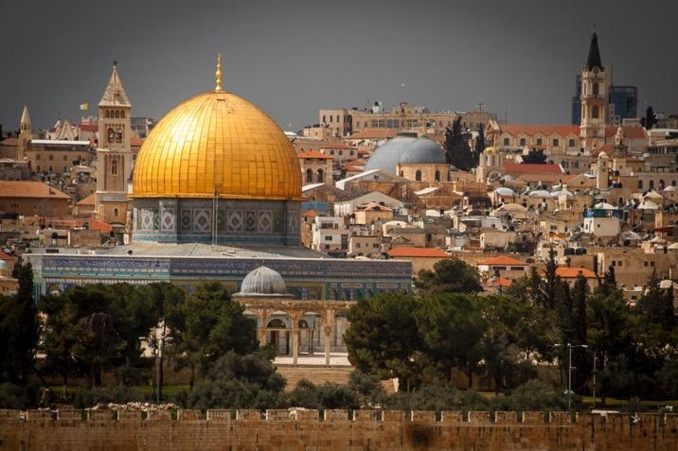
Monotheism
Belief in One God
Islam is a monotheistic religion.
Muslims believe that there is only One God.
Muslims believe they worship the same God as Abraham.
Notes:
Tip: Ask: What is one of the most important beliefs in Islam? Monotheism
Monotheism means the belief in one God.
All three faiths trace their history back to the Prophet Abraham, and are therefore commonly referred to as the three Abrahamic faiths.
The three world religions share a common belief in successive prophets and revealed scriptures.
Ask: Does anyone know how many Muslims there are in the world today? 1.8 billion

Slide 10
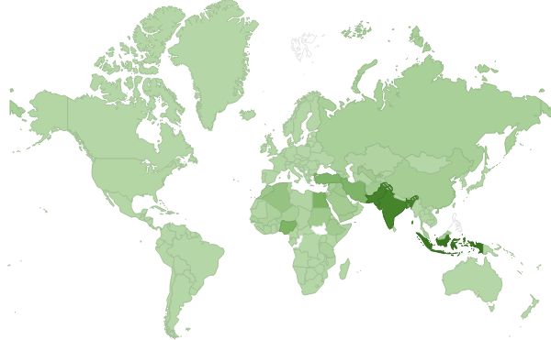
1.8 billion Muslims worldwide
(1/4 of the world’s population)
Indonesia 12.7%
Pakistan 11.0%
India 10.9%
Bangladesh 9.2%
United States 0.2%
Source: Pew Research Center, 2017

Slide 11
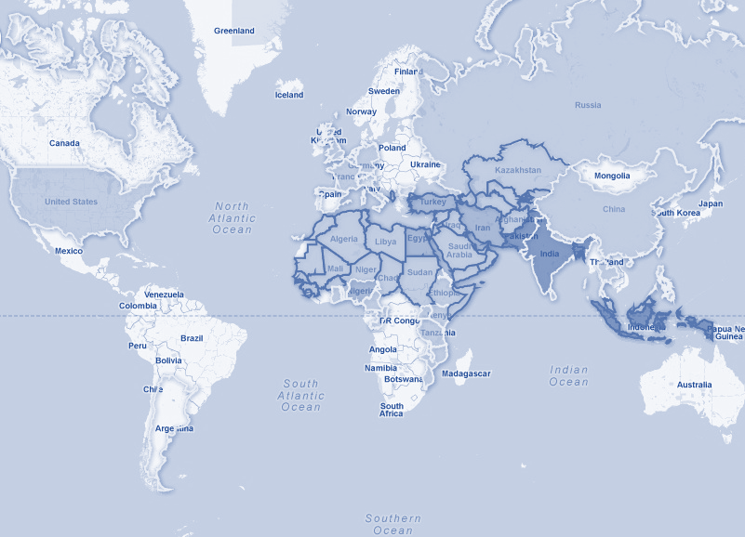
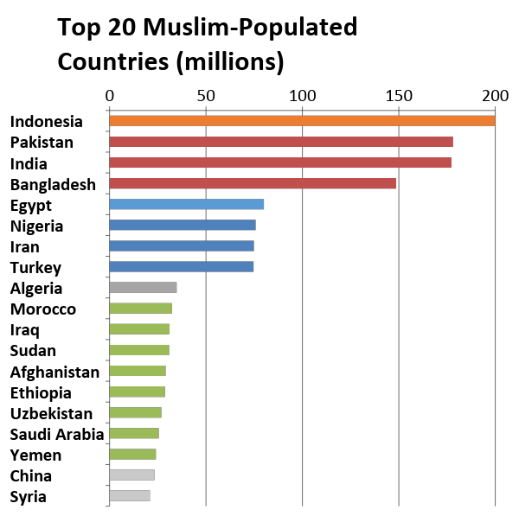
Source: Pew Research Center, 2017
Notes:
http://www.pewforum.org/2009/10/07/mapping-the-global-muslim-population/
Tip: (Statistics in this slide are estimates.)
The three highest populated Muslim countries are Indonesia, Pakistan and India. Arabic is not spoken as the first language in these countries. Many people think of Saudi Arabia or Egypt as the largest Muslim countries.
The vast majority of Muslims - 82% - do not speak or write Arabic, nor live in Arab countries.
In fact, not only are not all Muslims Arab, not all Arabs are Muslims.
About 10-15% of all Arabs are Christian or belong to another faith such as Judaism.
In fact, in America, most of the 3-4 million Arab-Americans are Christian.

Slide 12
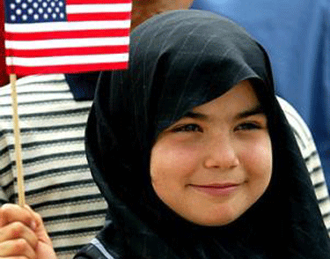
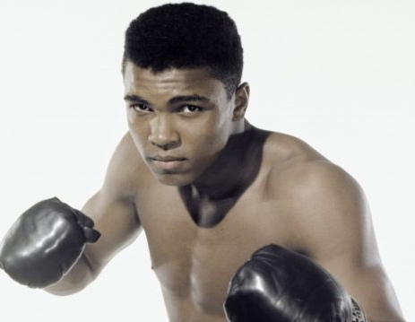
Islam
In America
It is estimated that 1/3 of the enslaved persons brought to America in the 18th and 19th centuries were Muslim.*
Many Muslims immigrated as homesteaders, auto workers, and entrepreneurs.
3.3 million Muslims** in the U.S. (1% of the population)
160,000 Muslims in Minnesota****
  73% First Generation African
Notes:
Source:
* Sylviane A. Diouf: Servants of Allah- African Muslims Enslaved in the Americas, NYU Press, 2013
** Pew Research Center, 2016
***Khan, Martinez: More than 5,000 Muslims Serving in US Military, Pentagon Say (…), 2017
**** John Mayer CityView Report, 2015

Slide 13
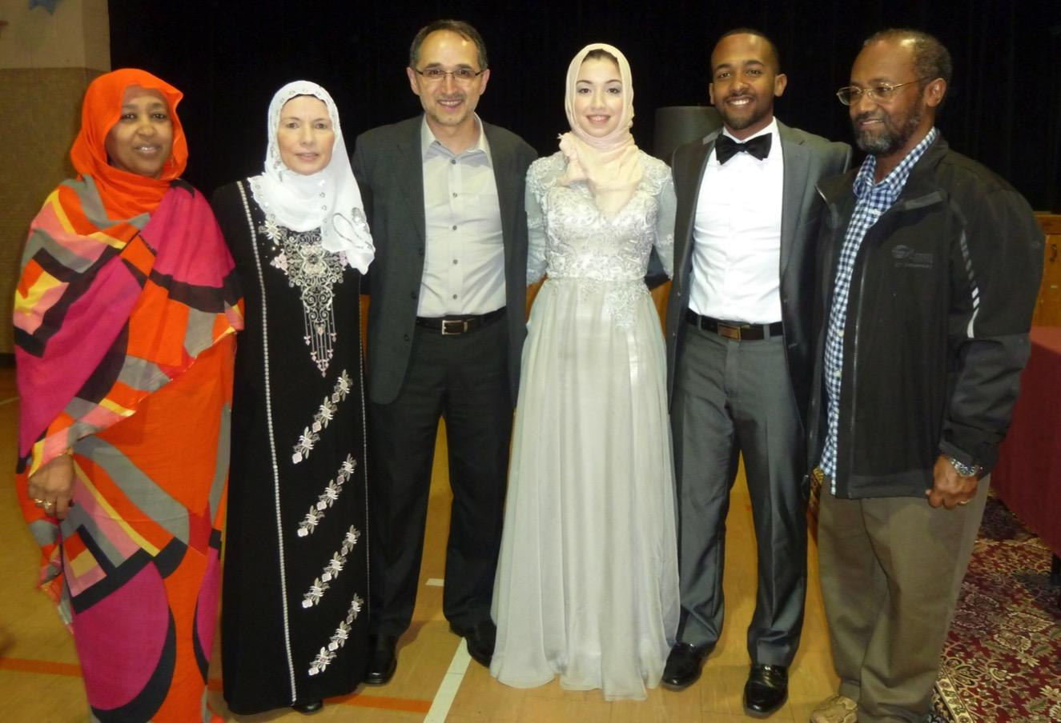
Islam and Culture
Two different factors in the lives of Muslims
One religion, many cultures
How does culture affect the life of a Muslim?
Notes:
One of the most common causes for misunderstanding Islam is the confusion between cultural practices of Muslims and the teachings of Islam.
Each one of us is impacted by many factors in our life such as ethnicity, race, nationality, and country of origin or where we live, as well as religious beliefs and practices.
Tip: You may now identify these things for yourself on the board as following:
Ethnicity (race): State your ethnicity
Nationality (citizenship): American
Religion: Islam
These three factors have an impact on people’s lives.
Tip: Then engage the audience in the following conversation:
Considering the factors above, although I am culturally American, speak English, eat American food, dress in American clothes that I bought at the mall, watch American movies, etc. can you tell me how my religion or ethnicity might affect all of these things?
Tip: Wait for them to answer and then elaborate on how your religion affects your way of life. For example:
Language: I don’t curse and know enough Arabic for prayers and to be able to speak to my grandparents (customize it according to your personal situation)
Food: I don’t eat pork or drink alcohol. I like Arabic food in addition to American food. (add in any traditional food you like).
Dress: I wear modest dress and sometimes I wear ethnic clothing from the Arab world (or name any traditional dress you wear from your own culture)
Movies: I avoid movies with sexual content or violence. I also like to watch movies in Arabic especially when I'm around my grandparents. Other Important Points:
Not everything that a person does in his/her life is motivated by religion. A person’s nationality, ethnicity or even special circumstances such as politics or economics shape that person’s activities.
All Muslims are not the same, nor do they have one monolithic culture, just as Christians around the world have many different cultures.
Look for example at the differences in clothing from different parts of the Muslim world. While all of them are modest, they take many different forms.
Tip: This is a good time to describe the ethnic clothing you brought in from different parts of the Muslim world, which emphasizes the interaction between Islam, in modesty of style, with culture, in fashion of the clothing.

Slide 14

Muslims believe in
God
Angels
Prophets
Holy Books
Day of Judgement
Divine Decree
Notes:
The most important belief to a Muslim is in the Oneness of God. You can imagine this belief as the strong trunk of a tree. And the tree has many leaves, which could symbolize our other major beliefs.
Now that we have finished reviewing the background on Islam, in which we addressed terminology, history, populations of Muslims around the world and the United States, and distinguished between culture and the religion of Islam, we are going to turn our attention to what Muslims around the world have in common, and what it means to be a Muslim.
Islam, like most faiths, is composed of beliefs and practices.
Muslims have six main beliefs, many of which are similar to Christianity and Judaism.
Muslims believe in One God, Angels, Prophets, Holy Books revealed to the Prophets, the Day of Judgment, and Divine Decree.
We will look at each of these beliefs individually.

Slide 15
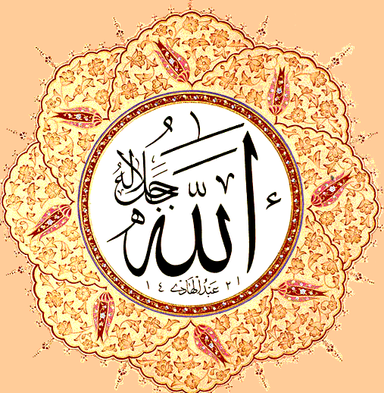
God
‘Allah’ is the Arabic word for God.
The word ‘Allah’
  No plural
  No gender
Attributes of God are found in the Quran
  Most Merciful
  All Forgiving
  All Loving
Notes:
All chapters in the Quran have the words In the Name of God the most Merciful the most Gracious.

Slide 16

Prophets
Descendants of Adam
Adam
Noah
Abraham
Isaac
Ishmael
Moses
Jesus
Muhammad
(Born in the year 570)
Notes:
Muslims do not worship Muhammad.

Slide 17
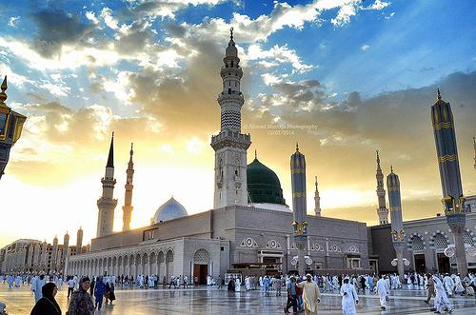
Muhammad
Born in Mecca, Saudi Arabia
First revelation through Angel Gabriel
Teaching of monotheism
Persecution
Migration to Medina
Beginning of Islamic calendar
Establishment of first Islamic community
Death of Prophet Muhammad
Spread of Islam to other areas
570
610
622
632
After 632
The Prophet’s Mosque
Medina, Saudi Arabia
Notes:
Muhammad (p) was born in Mecca in the year 570 CE into a noble family.
He was known as “the Trustworthy” because of his honesty.
Muhammad (p) was also known to not have followed the predominant religion of his time, polytheism.
Muslims believe that in the year 610 CE, Muhammad (p) was visited by the Angel Gabriel during the month of Ramadan while he was meditating in a cave on Mount Hira.
Muslims believe that it was there that the first verses of the Qur’an were revealed through the Angel Gabriel. The first verse was “Recite in the name of your Lord, who created you”.
This revelation continued until Muhammad’s (p) death in 632.
The aforementioned revelation and all the following revelations are now contained in the Quran, Islam's holy book.
The people of Mecca rejected the monotheistic message, and persecuted Muhammad (p) and his followers.
They first migrated to neighboring Abyssinia, where there was a Christian king who gave them refuge.
Eventually, in the year 622 CE, they migrated with the Prophet (p) to the neighboring town of Medina, where they were able to openly practice Islam.
This migration is called the Hijra, which means to migrate, and is an important date in Muslim history, because it marks the beginning of the Islamic calendar.
That means the Islamic calendar is approximately 600 years later than the Gregorian calendar.
Tip: If your time allotted for the presentation is 90 minutes, then you may want to elaborate on the differences between the Christian and Islamic calendars as follows:
The Islamic calendar is lunar, like many other calendars, i.e. the Chinese or Jewish calendar. However, unlike these other calendars, it is a purely lunar calendar, based on the cycle of the moon, and so it is 11 days shorter than the cycle of the Gregorian solar calendar, which is 365 days.
That is why Islamic holidays fall 11 days earlier each year on the Gregorian calendar.
Tip: Demonstrate an example of this by giving the date for the beginning of Ramadan this year compared to the year before.
After the migration or hijra, when Muhammad (p) and his followers reached Medina, the people of the city embraced Islam and Muhammad (p) as their leader.
Islam prospered in Medina and eventually spread to Mecca and the entire Arabian Peninsula.
In 632 CE Muhammad (p) died and was buried in Medina.
After 632 CE Islam began to spread to neighboring areas and eventually to much of the world.
Today there are over 1.8 billion Muslims in the world.

Slide 18
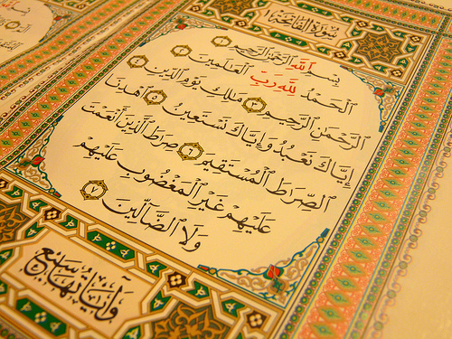

Quran
Holy Book of Islam
Revealed in Arabic to Muhammad by God through Angel Gabriel
Revelation spread over 23 years
Primary source of guidance
Last revelation from God to humanity
Notes:
The Quran literally means "the reading" or "recitation" and is considered by Muslims to be the last and final revelation from God.
Muslims believe that God sent down the Quran to the Prophet Muhammad (p) over a period of 23 years between 610 and 632 C.E. in Arabic through the Angel Gabriel.
The Quran contains stories about the prophets with morals and lessons, as well as commandments and prohibitions.
The Quran consists of more than 6,000 verses, which are divided into 114 chapters of varying lengths; some are very long, others are very short.Since the Qur'an is considered by Muslims to be the word of God, Muslims try to read it in its original form in Arabic, although it has been translated into every language Muslims speak, including some twenty translations in English.
There are actually millions of Muslims throughout the world who have memorized the entire Qur'an, even though Arabic is not their native tongue.
Tip: You may play the audio button on this slide for an example of recitation from the Quran. It plays Chapter one, ‘Al-Fatiha’.

Slide 19
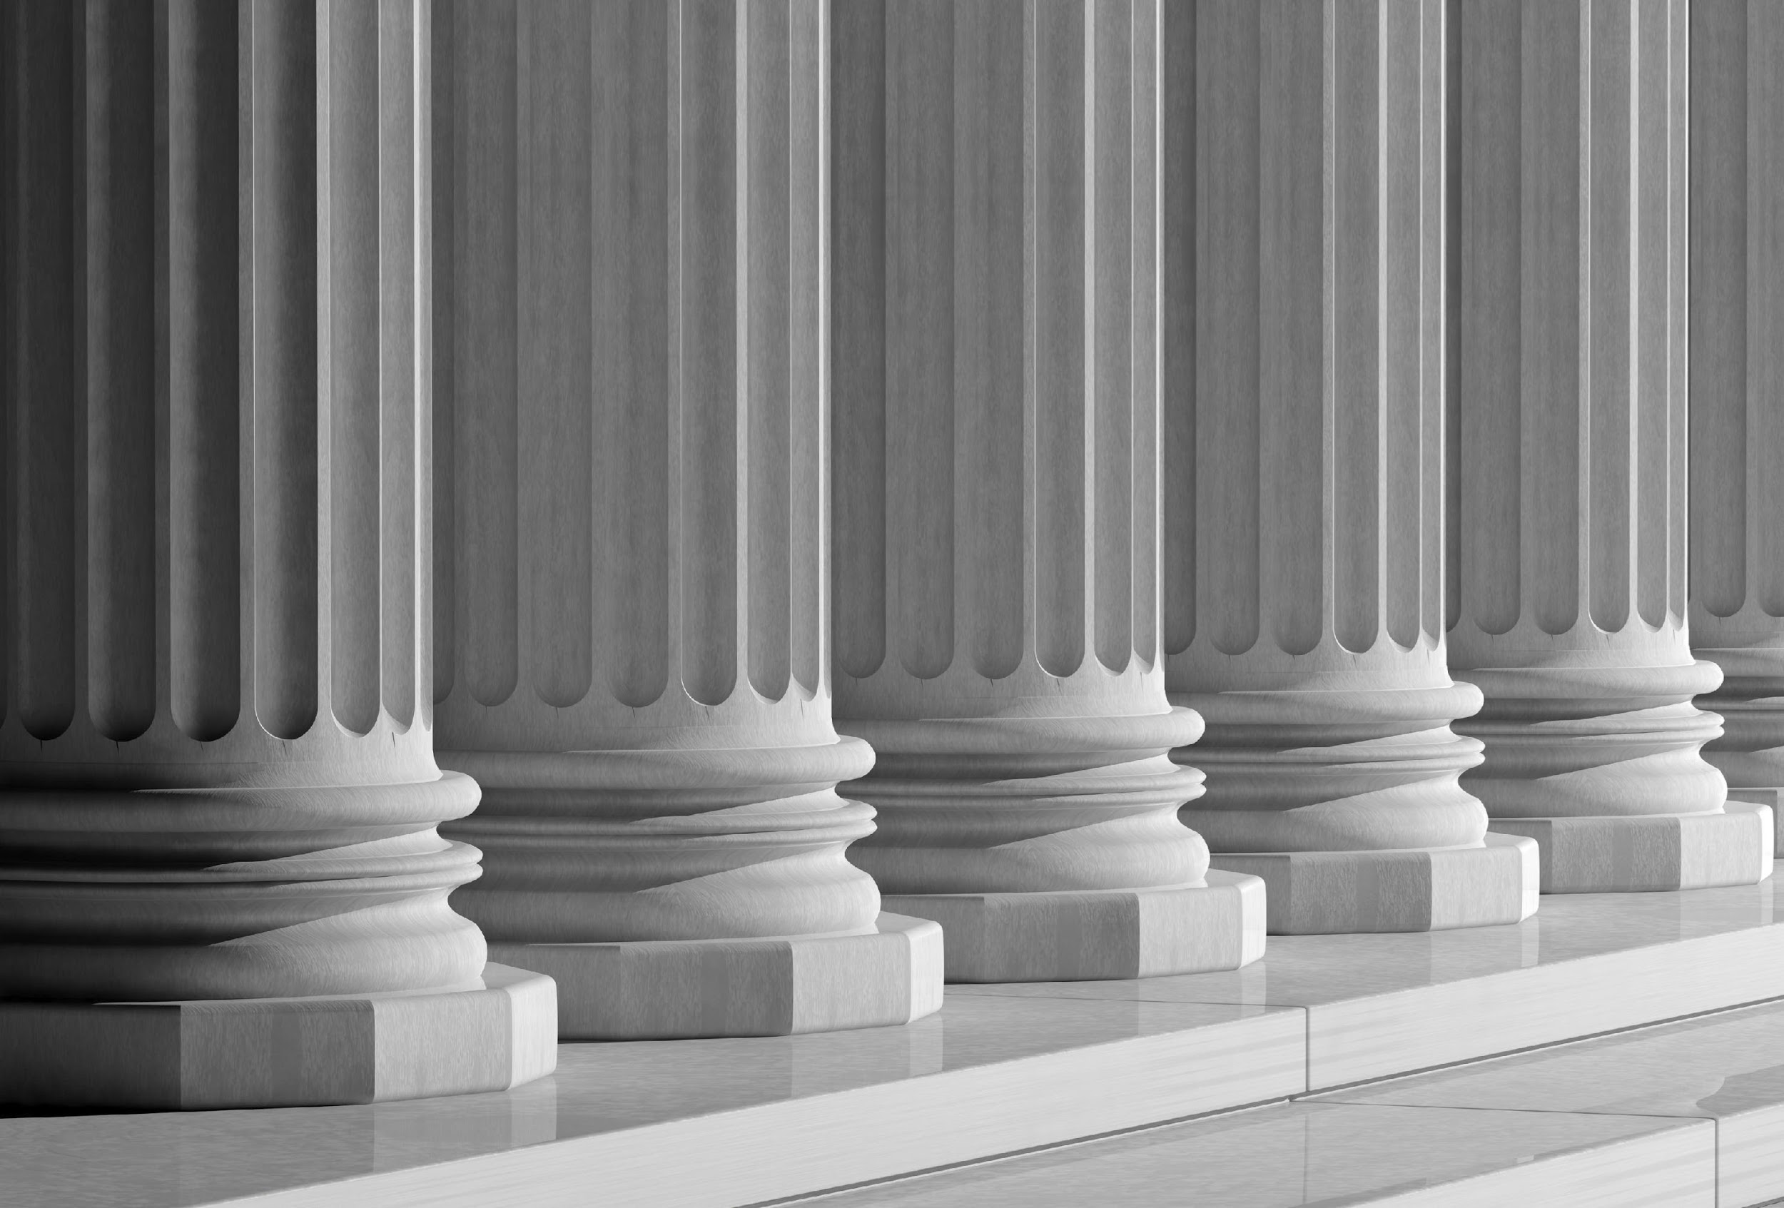
Five Pillars in Islam
Declaration of Faith
Prayer
Charity
Fasting
Pilgrimage
Notes:
Tip: Ask, can anyone name some of the pillars? The students should know them already since the textbooks emphasize the pillars more than they do beliefs.
To help and support a Muslim in achieving a moral personality, Islam prescribes certain acts of worship.
Worship in Islam can include any act a Muslim does with the purpose of pleasing and serving God, whether it be helping an old person across the street, greeting a friend, or even hugging one's child.
There are also specific acts of worship called the "Five Pillars of Islam" that provide the spiritual support for a Muslim, just like pillars support and hold up a building.

Slide 20


www.irgMN.org

Slide 21
Thank you so much for attending!

