Slide 1
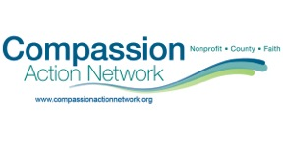
CAN Connect presents:
Restorative Justice Practices in Our Community

Slide 2
Restorative Principles, Circle Practices
Nancy Riestenberg
Restorative Practices Specialist
Minnesota Department
of Education
Nancy Riestenberg
Restorative Practices Specialist
Minnesota Department
of Education

Slide 3
Introductions
Share your name and a hidden skill

Slide 4
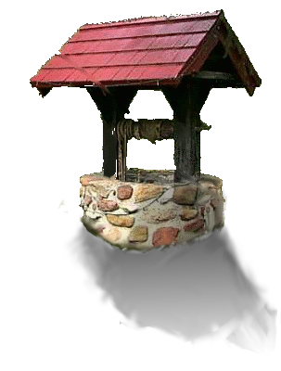
Notes:
Cholera outbreak in London: people went to the hospital to get better, but got sick again when they returned to their home. Not until the well was sealed, the source of the infection, did people get better. Likewise, you can have fabulous interventions in the school office, but if the student returns to a mean, chaotic classroom and hallway, they may get sick again.
Original map by John Snow showing the clusters of cholera cases in the Soho , London epidemic of 1854
By talking to local residents (with the help of Reverend Henry Whitehead), he identified the source of the outbreak as the public water pump on Broad Street (now Broadwick Street).^{[1]} Snow later used a spot map to illustrate how cases of cholera were centered around the pump. He also made a solid use of statistics to illustrate the connection between the quality of the source of water and cholera cases. Snow's efforts to connect the incidence of cholera with potential geographic sources centered around creating what is now known as a Voronoi diagram. He mapped out the locations of individual water pumps and generated cells which represented all the points on his map which were closest to each pump. The section of Snow's map representing areas in the city where the closest available source of water was the Broad Street pump circumscribed most cases of cholera.^{[2]} He showed that the Southwark and Vauxhall Waterworks Company was taking water from sewage-polluted sections of the Thames and delivering the water to homes with an increased incidence of cholera. Snow's study was a major event in the history of public health and health geography, and can be regarded as the founding event of the science of epidemiology.
Wikipedia, retrieved 4/9/2012 http://en.wikipedia.org/wiki/1854_Broad_Street_cholera_outbreak

Slide 5
Building
Community
Restorative School
Repairing
Harm

Slide 6
Restorative Practices are based on:
Indigenous Wisdom
Current Restorative Justice theory
Affect Script Psychology
Quality Schools, William Glasser
Peaceable Schools
Social Emotional Learning (SEL)
Resilience Research
Positive Youth Development Theory
Conflict Resolution Education

Slide 7
Harm & needs, obligations and engagement
Who has been hurt?
What are their needs?
Whose obligations are these?
“If crime hurts, justice should be healing.”
Zehr, 2002

Slide 8
Compare and Contrast
Formal System
What was the rule and who broke it?
What is the punishment per the student handbook?
Administrator decision
Restorative Approach
What was the harm and who all was affected by it?
How do we make amends, repair the harm, re-connect all to community?
Victim/Offender/
Community decision

Slide 9
Restorative Practice: repairing harm
Person(s) harmed
Person(s)
who did harm
Community
talk it through
identify solutions
restore order
conflict/problem/harm done :

Slide 10
Person harmed
Offered opportunity to express feelings
Can get questions answered
Say what is needed for her/him to feel safe again
Discuss retaliation issues
Say what she/he thinks the consequences should be
Get support from other participants

Slide 11
Those who do harm
Have a chance to be responsible for their actions
Have opportunity to right their wrongs
Have a chance to be part of the solution
Can learn from what happened
Have an opportunity to develop empathy
Can get assistance to alter or change behavior

Slide 12
The community’s role
An alternate way to address problems Acknowledges the harm done to the community
Allows for fuller representation of all members of the community
Communities (schools) can take responsibility for conditions which may exist that contribute to the problem

Slide 13
Restorative Conference
Voluntary (choice for offender)
Have to admit harm
Willing to problem solve
Any party can stop at any time
Conducted by a trained facilitator

Slide 14
Characteristics of Restitution ( D. Gossen)
Satisfactory amends to the victim
Effort required
Little incentive for repetition
Relevant to the situation where possible

Slide 15
Characteristics…
Tied to a higher value, mission statement
Strengthens the person who has offended
No resentment by the planner/helper
Restraint of criticism, guilt or anger

Slide 16
Practices
Affective Statements
Listening and Speaking using the language of feeling, of empathy
Restorative Conversations
With one or two people or a small group
Circles
To build relationships, to teach, to meet, to problem-solve, to repair harm, to provide on-going support
Conferences
To repair harm, to problem-solve

Slide 17
Building
Community
Restorative School
Repairing
Harm

Slide 18
COLLECTIVE ACTION
COMMUNITY BUILDING
CONNECTIONS
HEALING
GUIDELINES
TALKING PIECE
CIRCLE KEEPING
CONSENSUS
CEREMONY
INDIGENOUS
TEACHINGS
SHARED VALUES
© Kay Pranis
Notes:
The tree is a metaphor for the circle process.
At this time reference the circle in the corner – or reference the circle in the room.
The process is rooted in shared values and aboriginal/native roots
The process is defined in the trunk: talking piece, open/close, consensus, keeper, guidelines
The fruit of the tree: community building, healing, and connections.
**Storytelling could be seen as the rain.** as it touches all parts in some way or another.
Types of circles: celebration circle, healing circle, community building circle, circle of understanding, talking circle, circle of support, reintegration circle, circle sentencing.

Slide 19
Common Agreements
Respect the talking piece
Speak from the heart
Speak with respect
Listen with respect
Remain in the circle
Honor confidentiality
You may pass
-Pranis, Stuart and Wedge

Slide 20
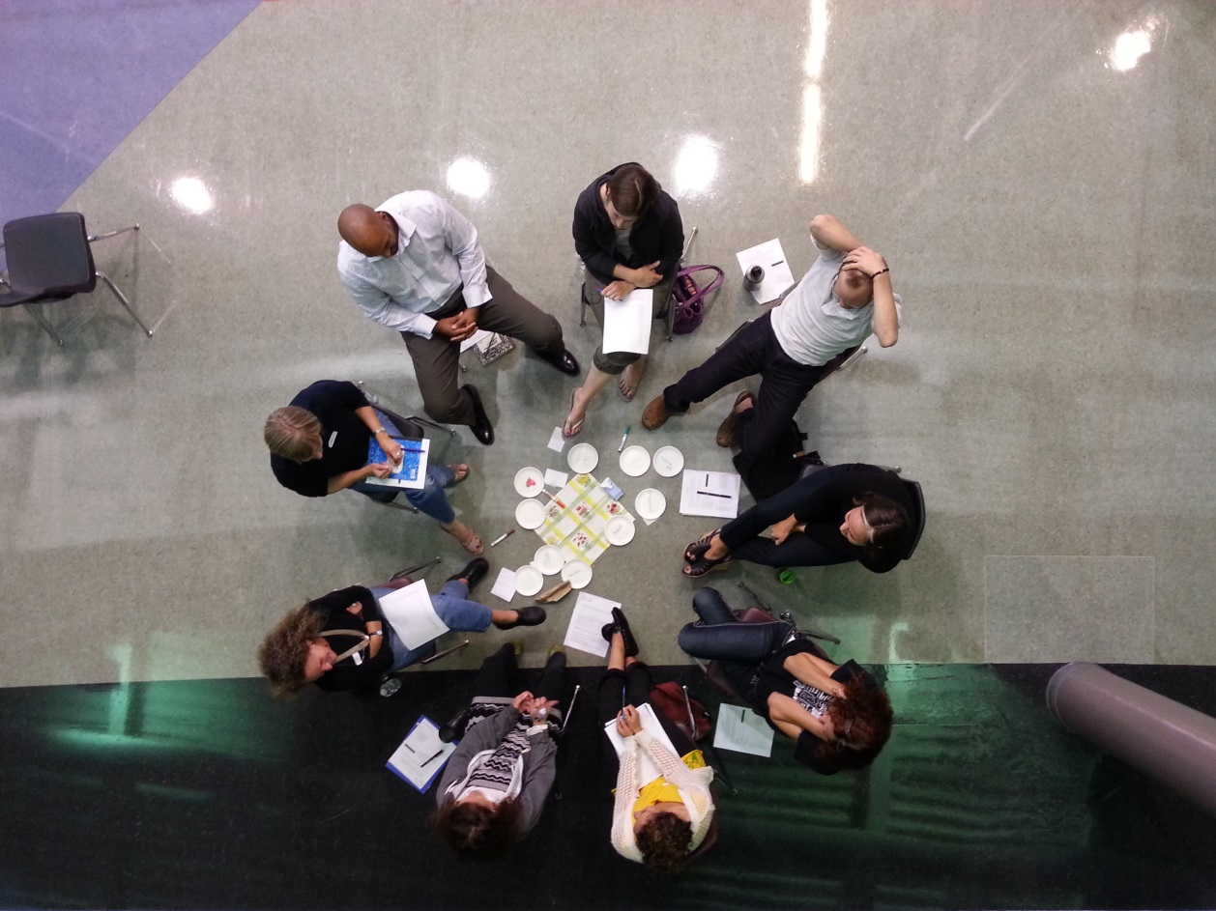
Circle
Buy-in

Slide 21
Relationships
Human beings are relational and thrive in contexts of social engagement over control.
Morrison, 2007
There is simply no substitute for the personal.
Building respectful relationships is foundational and an outcome of any process.
Oakland Unified School District Restorative Practices Implementation Guide, 2016

Slide 22
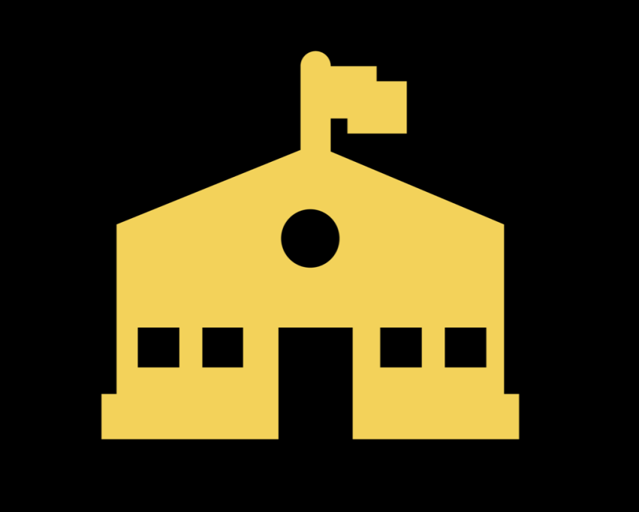
Community
Building a strong caring
community is the foundation of a
healthy school.
Everyone wants to be in good relationship with each other and with themselves:
Feel respected,
Have a sense of dignity,
Feel as if they matter to others,
Fee that they are valued.
Boyse-Watson & Pranis, 2015

Slide 23
Social Justice and Equity
“Restorative justice promotes values and principles that use inclusive, collaborative approaches for being in community.
These approaches validate the experiences and needs of everyone within the community, particularity those who have been marginalized, oppressed, or harmed.
These approaches allow us to act and respond in ways that are healing rather than alienating or coercive.”
Stutzman Amstutz & Mullet, 2005
Notes:
Nancy: if bullying is a relational problem, then restorative practices provide one of the solutions.
Bullying happens in a context—the student who bullies, the person targeted and helpful or hurtful bystanders are all affected by the behavior. Bringing them all together, engaging the parents in a respectful, open and transparent way, helps to address the challenges of this very hurtful behavior.
A restorative process is not mediation.
Pranis, K (2007). Restorative Values. In G. Johnstone & D. Van Ness (Eds.), Handbook of Restorative justice (pp. 59-74). Cullompton, England: Willan.
Morrison, B. (2011). From social control to social engagement: Enabling the “time and space” to talk through restorative justice and responsive regulation. In R. Rosenfeld, K. Quinet, & C. Garcia (Eds.), Contemporary issues in criminology theory and research (pp. 97-106). Belmont, CA: Wadsworth.

Slide 24
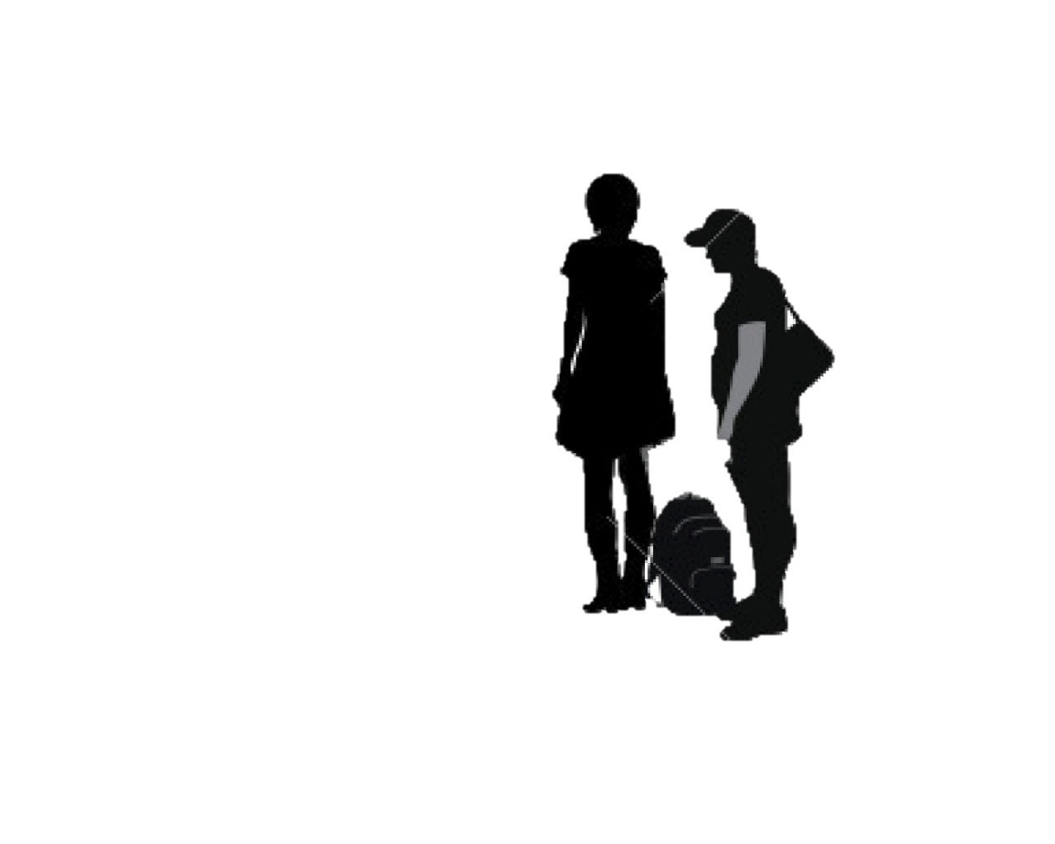
Taking responsibility
Real accountability comes from understanding the impact of one’s behavior and actions on another person
And an attempt to acknowledge and put things right when that impact is negative
Stutzman Amstutz & Mullet, 2005

Slide 25
A story
The fight and the apology

Slide 26
Restorative discipline shifts from
Telling
Knowing the answers
Institution/third party trying to restore balance
Focus on wrongdoer
External coercion
To listening
To being curious
To those affected trying to restore balance
To focus on those harmed and those who caused harm
Internal motivation
B Hopkins

Slide 27
References
Boyes Watson, C & Pranis, K. (2015. Circle Forward: Building A Restorative School Community. Living Justice Press, St. Paul, MN www.livingjusticepress.org
Costello, Wachtel & Wachtel (2009). The Restorative Practices Handbook, International Institute for Restorative Practices http://www.iirp.edu/.
Hopkins, B. (2004). Just Schools: A Whole School Approach to Restorative Justice. Jessica Kinsley Press, London, UK: www.jkp.com.
Morrison, B. (2007). Restoring Safe School Communities: a whole school response to bullying violence and alienation, Brenda Morrison, Federation Press, 2007, www.federationpress.com.au.
Stutzman Amstutz & Mullet, The Little book of Restorative Discipline for Schools: Teaching responsibility; creating caring climates. Good Books, Intercourse, PA
Thorsborne and Vinegrad, (2006). Restorative Practices and Bullying: Rethinking Behaviour Management. Inyahead Press, www.inyahead.com.au.
Yussum, et, al. (2014) Oakland Unified School District Restorative Practices Implementation Guide, 2016. contact David Yusem (david.yusem@ousd.org).
Zehr, H. (2002), The Little book of Restorative Justice. Good Books, Intercourse, PA

Slide 28
MDE.SSTAC@state.mn.us | 651.582.8364

Slide 29
Our Mission:
To foster collaborative opportunities to creatively address community needs in Anoka County.
If there is a topic you would like CAN to cover at the next event, please talk to us after or visit our website and send us a message
www.compassionactionnetwork.org

Slide 30
Thanks in Advance for Your Contribution

Slide 31
Thank you so much for attending!
For resources on local restorative justice initiatives be sure to check out:
Community Circles Initiative, working with Washing County Community Circles (WCCC)
Mediation Services for Anoka County
Anoka County Attorney’s Office

