Slide 1
Welcome

Slide 2
Our Mission:
To foster collaborative opportunities to creatively address community needs in Anoka County.
If there is a topic you would like CAN to cover at the next event, please talk to us after or visit our website and send us a message
www.compassionactionnetworkanoka.org

Slide 3
Speaker
Coleen Moriarty, Executive Director, Hunger Solutions
Colleen has been involved in poverty programs for the majority of her career. She has seen the devastating effects that poverty has had on our families and children and understands that basic needs must be met before families can succeed. As Hunger Solutions’ Executive Director and the chair of Minnesota Partners to End Hunger, she works to motivate decision-makers to take supportive action on state and national hunger policy issues.
Panelists
Annabelle Budde, Executive Director of NACE Food Shelf
Sonja Traisci, Anoka County Economic Assistance SNAP Outreach
Jessica Jasurda, Homeless Liaison with Anoka-Hennepin Schools
Jeff Lundgren, Executive Director of North Metro Pediatrics

Slide 4
Hunger in Minnesota (and what we can do about it)

Slide 5
What is Hunger/ Food Insecurity?
USDA’s definition of food insecurity
Lacking the money or resources necessary to have consistent and dependable access to enough food for all family members.
Notes:
Food insecurity is not having the access either financially or geographically to purchase nutritionally adequate (healthy) & culturally relevant food in a way that the general population does, like from a grocery store.

Slide 6
1 in 10
Minnesotans
is food insecure
Notes:
Poverty is often seen as something that is only a problem in the developing world. But in reality it’s in our own back yard. We have pockets of extreme poverty across the country including right here in Minnesota.

Slide 7
Food insecurity by poverty level, 2017
Source: USDA Economic Research Service. Household Food Security in the United States 2017.
Notes:
For low income households living at 100% or bellow the federal poverty level (an income of $24,300 a year for a family of four) food insecurity is high – about 1 in 5 low income households are food insecure, and between 1 in 7 are very food insecure which means that, at times during the year, the food intake of household members is reduced and their normal eating patterns are disrupted because the household lacks money and other resources for food.
This graph shows what percentage of the population are dealing with hunger, based on income. Some families living at 185% of the poverty level still face real challenges related to hunger.

Slide 8
Hunger is a Racial Equity Issue
Households of Color
21.8%
White
Households
8.8%
Notes:
While 10% of white households experience hunger, households of color experience huger rates of up to 21.5%
Schools with majority white students spend $733 more per student than schools with majority of students of color
Provide less fresh fruits and low fat milk options
And are half as likely as to adopt and enforce health standards on vendor foods

Slide 9
Minnesota ranks very well on food insecurity
Minnesota is tied with Alaska for 3rd lowest food insecurity rate nationally:
North Dakota 8.4
Hawaii 10.2
Minnesota 10.8
Alaska 10.8
Iowa 11.0
Minneapolis-St. Paul-Bloomington MSA ranks 5th best among cities:
San Jose, CA 9.8
Madison, WI 10.2
Provo-Orem, UT 10.5
Urban Honolulu, HI 10.6
Minneapolis-St. Paul, MN 10.8
Albany-Schenectady, NY 11.3
Source: How Hungry is America? FRAC’s National, State, and Local Index of Food Hardship. June 2016.
Notes:
We do really really well in Minnesota when it comes to food insecurity measures

Slide 10
How do we solve hunger in Minnesota?
Emergency Food System
(Food banks, food shelves)
Strong public programs
(SNAP, WIC, school meals)
“Up stream” solutions
(living wage, paid family leave, housing)
Volunteers, Donors
Advocates

Slide 11
How do we solve hunger in Minnesota?
Emergency Food System
(Food banks, food shelves)
Strong public programs
(SNAP, WIC, school meals)
“Up stream” solutions
(living wage, paid family leave, housing)
Volunteers, Donors
Advocates

Slide 12
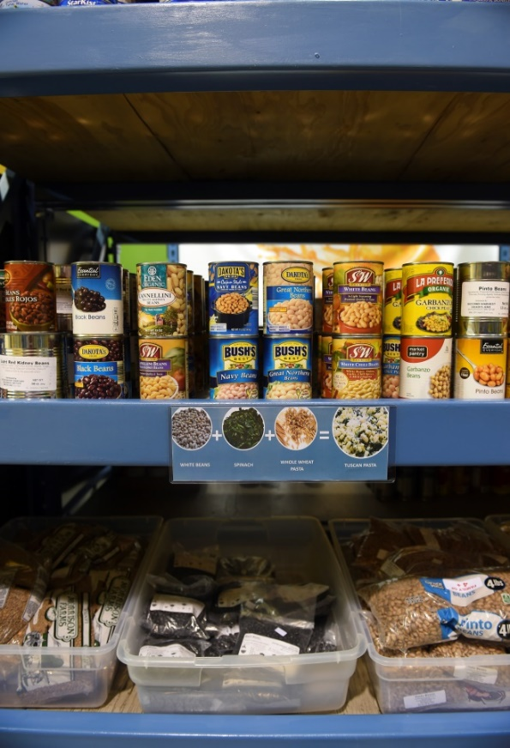
Emergency Food System
Food Banks Food Shelves Meal Programs
Notes:
We work with 7 Food Banks and over 300 TEFAP participating food shelves and many meal programs in the state of MN. TEFAP is The Emergency Food Assistance Program is federally funded and supplies commodity foods through the food banks to food shelves. Most of the items are staple foods.

Slide 13
Food shelf trends
Number of visits rose quickly during recession and have stayed high
7 years in a row over 3 million visits per year

Slide 14
Other programs fighting hunger
Meals on Wheels
Meal programs
Fare for All
Market Bucks

Slide 15
Other programs fighting hunger
1-888-711-1151

Slide 16
How do we solve hunger in Minnesota?
Emergency Food System
(Food banks, food shelves)
Strong public programs
(SNAP, WIC, school meals)
“Up stream” solutions
(living wage, paid family leave, housing)
Volunteers, Donors
Advocates

Slide 17
Federal programs: SNAP
The Supplemental Nutrition Assistance Program (SNAP )
(formerly known as food stamps)
Helps millions of low-income Americans put food on the table
Benefits are delivered via EBT card
(used like a debit card) used to buy
groceries
Notes:
SNAP helps low income families put food on the table. A household of 3 must make less than $33,700 a year to qualify.
The average monthly benefit in Minnesota is $105 per household. The average benefit from SNAP in Minnesota is just $1.17 per meal.
In Minnesota, 46% of people served are children, 15% are adults with disabilities, 9% are seniors.
Largest and most effective anti-hunger program in the country – it lifts over 4 million Americans above the poverty line.

Slide 18
For every one meal provided by food shelves, SNAP provides 12 meals.
1 meal from food shelf
12 meals from SNAP

Slide 19
Federal programs: TEFAP (The Emergency Food Assistance Program)
Commodity foods purchased by the federal government
Distributed to food shelves, meal programs through food banks

Slide 20
Do these programs work?
SNAP participation reduces food insecurity by about 31.2%.
Public programs lift people above the poverty line:
SNAP: 4.6 million people
WIC: 400,000 people
School meals: 1.3 million people

Slide 21
Be an advocate!
Contacting your lawmakers is the most effective way to make a difference on hunger policy.
Sign up at http://www.hungersolutions.org/get-involved/advocate/
Get quick & easy scripts to make calls, send emails.

Slide 22
Partners to End Hunger Agenda
Fully fund the good food access program
Improve school breakfast
End school lunch shaming
Continue mobile food shelf funding

Slide 23
Partners to End Hunger Agenda
Farm to school and early care
Urban agriculture grant program
Hunger free campuses

Slide 24
Questions? Contact:
Jill Westfall
Communications Manager
jwestfall@hungersolutions.org
651-789-9843
http://hungersolutions.org
Notes:
Add Joe 789-9849

Slide 25
Panelist
Annabelle Budde
Executive Director
NACE Food Shelf

Slide 26
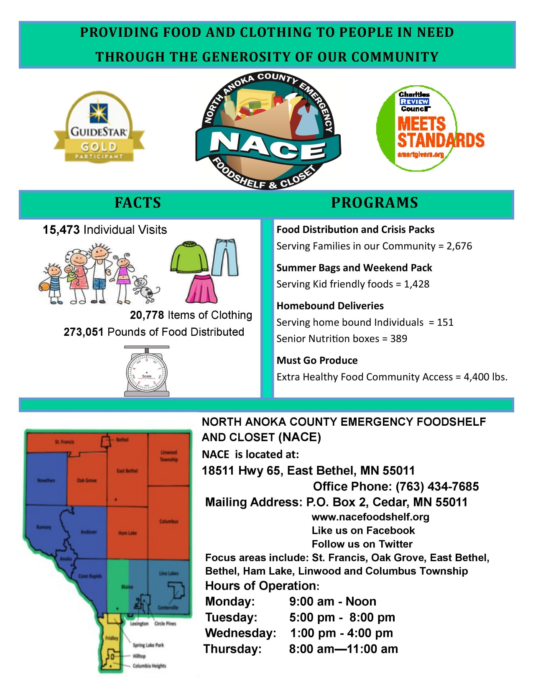

Slide 27
IT ALL COMES DOWN TO YOU!
Awareness
Compassion
Change
Spread the Word

Slide 28
Panelist
Sonya Traisci
Anoka County Economic Assistance SNAP Outreach

Slide 29
Anoka County Economic Assistance
Supplemental Nutritional Assistance Program (SNAP) Outreach

Slide 30
History and Introduction
Food security is essential in establishing and maintaining good health. The Supplemental Nutritional Assistance Program (SNAP), formerly known as food stamps (name officially changed 10/01/2008), is a crucial public safety net program designed to protect Americans from hunger and food insecurity. The federal government provides funding and legislates the rules and regulations for SNAP while the individual states administer the program at the local level. Research has shown that it also plays a key role in the recipients ability to achieve and sustain academic success, steady employment and stable housing.
The idea for the program was born in the late 1930’s under Franklin D. Roosevelt, with a limited program in effect from 1939-1943
It was revised as a pilot program in 1961 under John F. Kennedy and was extended nationwide in 1974.
Permitting low-income households to obtain a more nutritious diet through normal channels of trade implemented the current program structure in 1977 with a goal of alleviating hunger and malnutrition
The program originally provided food coupons to eligible low income families. The electronic benefit transfer system (EBT) has replaced paper coupons through use of a benefits card, similar to a bankcard
USDA reports that all 50 states, DC and Puerto Rico are now using the EBT system.
SNAP is a SUPPLEMENTAL FOOD PROGRAM-it was never intended to meet all of the households food needs.

Slide 31
Where can I apply?
Online: ApplyMN.dhs.mn.gov.
Call the Anoka County EZ-Info line at 763-422-7200 to request an application in the mail, and get information on intake hours and locations.
Application assistance and application links are also provided by community agencies such as Second Harvest, ACCAP etc.

Slide 32
Application Process
The day we receive page 1 of the Combined Application Form containing your name, address, and signature sets the date of application.
Assistance Standards
Once the application is received the worker will contact the client for a phone interview.
Verifications that may be requested include id, last 30 days income, current rent verification for deduction, etc.
DHS requires the county to process applications within 30 days. Some situations may qualify for expedited service.

Slide 33
EBT
May be used for any type of food except for hot, prepared in store items.
Client may be eligible for free government cell phone if participating in SNAP.
Reduced or free admission to many museums, zoo’s, historical sites, plays, etc.

Slide 34
Anoka County Respectful, Innovative, Fiscally Responsible
Thank you for your time today.
sonya.traisci@co.anoka.mn.us
Anoka County Economic Assistance SNAP Outreach

Slide 35
Panelist
Jeff Lundgren
Executive Director
North Metro Pediatrics

Slide 36
Jeff Lundgren – Executive Director North Metro Pediatrics

Slide 37
OUR MISSION
North Metro Pediatrics' Mission is to improve the health and well being of children and teens in the North Metro by providing affordable and accessible primary care focused on prevention.

Slide 39
https://en.oxforddictionaries.com/definition/nutrition

Slide 40
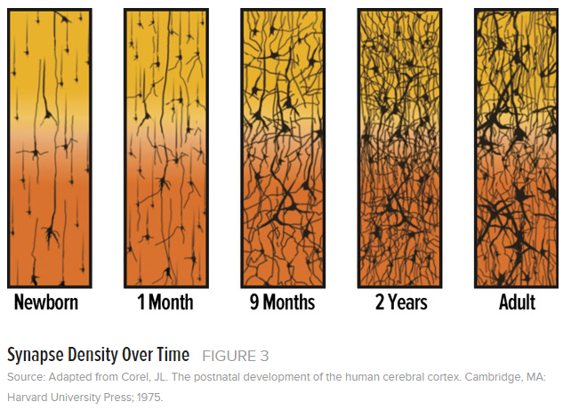
FOOD INSECURITY – HOW IT AFFECTS KIDS
Food insecurity translates to higher developmental risk among children
80% of our neuropathways are developed by the age of 3
Nutrition is an essential part of healthy brain development
Food insecurity is not the same as hunger – families facing food insecurity often resort to cheaper and more accessible food

Slide 41
FOOD INSECURITY – WHAT WE’RE DOING ABOUT IT
100% of NMP’s clients who receive preventive care are screened for food insecurity
If they screen positive, they are referred to resources that can directly help them
Our providers can also connect them with local food resource locations and times
Last year we integrated the screening tool into our Electronic Health Record
Closed loop referral process

Slide 42
Panelist
Jessica Jasurda
Homeless Liaison
Anoka-Hennepin Schools

Slide 43
Jessica Jasurda, MSW, LGSW
Homeless Liaison
Anoka-Hennepin Schools

Slide 44
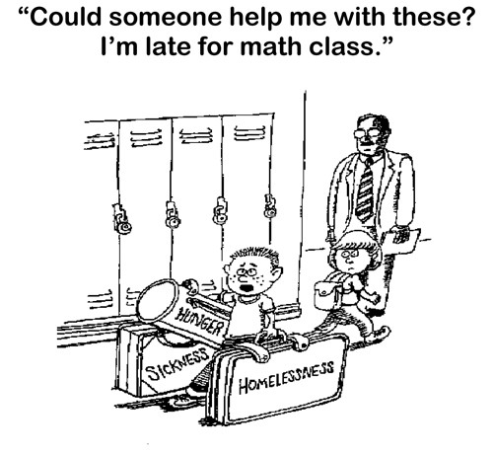
Notes:
For many children and youth, often the most nutritious meal in a day is the one that they receive through the school breakfast or lunch programs.
Good nutrition is an important contributor to students’ abilities to focus in class and succeed academically.
Child Nutrition Programs - Free & Reduced Meals
Children from families with incomes at or below 130 of the poverty level are eligible for free meals while children from families with incomes between 130% to 185% of federal poverty level are eligible for reduced price school meals.
Based on 2018 enrollment data, 34.65% of the total student population eligible for free and reduced priced meals.

Slide 45
Rights of students experiencing homelessness
School Transportation
School Nutrition
categorical eligibility
automatic enrollment
Educational Stability
Immediate Enrollment
Notes:
The term “homeless children and youth” means individuals who lack a fixed, regular, and adequate nighttime residence…
McKinney-Vento Act - federal legislation that establishes the educational definition of homelessness to have access to free, appropriate public education, authorizes rights and services aimed to provide educational stability and continuity for students experiencing housing transitions and requires districts to designate a Homeless Liaison to oversee implementation of the Act throughout all school districts.
are sharing the housing of other persons due to loss of housing, economic hardship, or a similar reason;
are living in motels, hotels, trailer parks, or camping grounds due to the lack of alternative adequate accommodations;
are living in emergency or transitional shelters;
are abandoned in hospitals;
have a primary nighttime residence that is a public or private place not designed for or ordinarily used as a regular sleeping accommodation for human beings…;
living in cars, parks, public spaces, abandoned buildings, substandard housing, bus or train stations, or similar settings;
migratory children live in any of the previously described circumstances.
duration of the school year
30 days after the first operating day of the next school year, or until a new eligibility determination is made

Slide 46
Role of schools in addressing hunger
The experience of homelessness can create barriers to accessing food programs due to:
lack of documents - high mobility - lack of adequate transportation
Schools play a vital role in providing students with access to food support, including after school and on weekends through connection to:
Notes:
Connection to:
Federal programs, state programs, local/community food programs (food shelves, community meal sites, food distribution programs)
Community collaborations: Faith Community Partnerships

Slide 47
Notes:
The Faith Community Partnership is a collaborative effort of the Anoka-Hennepin School District and faith-based organizations, connecting schools and communities to mobilize people to meet the needs of students.

Slide 48
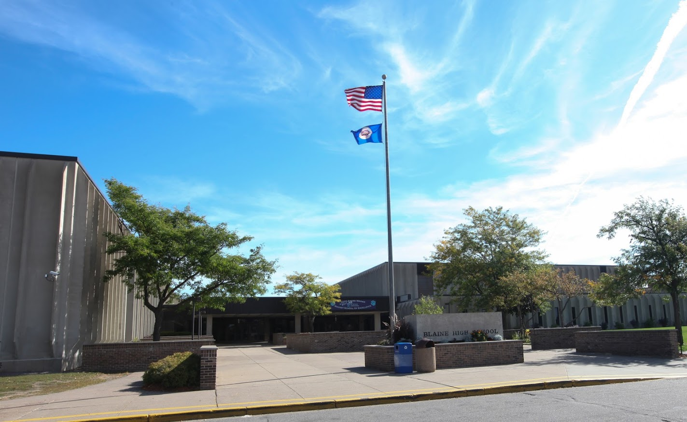
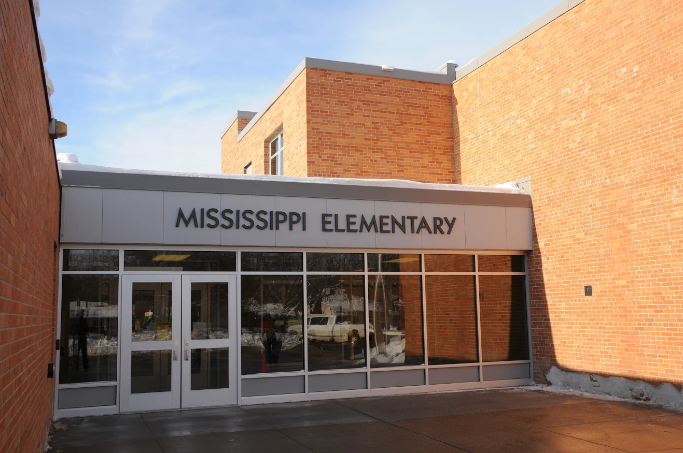
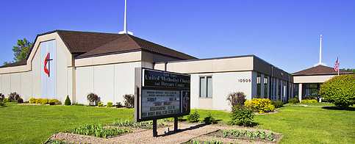
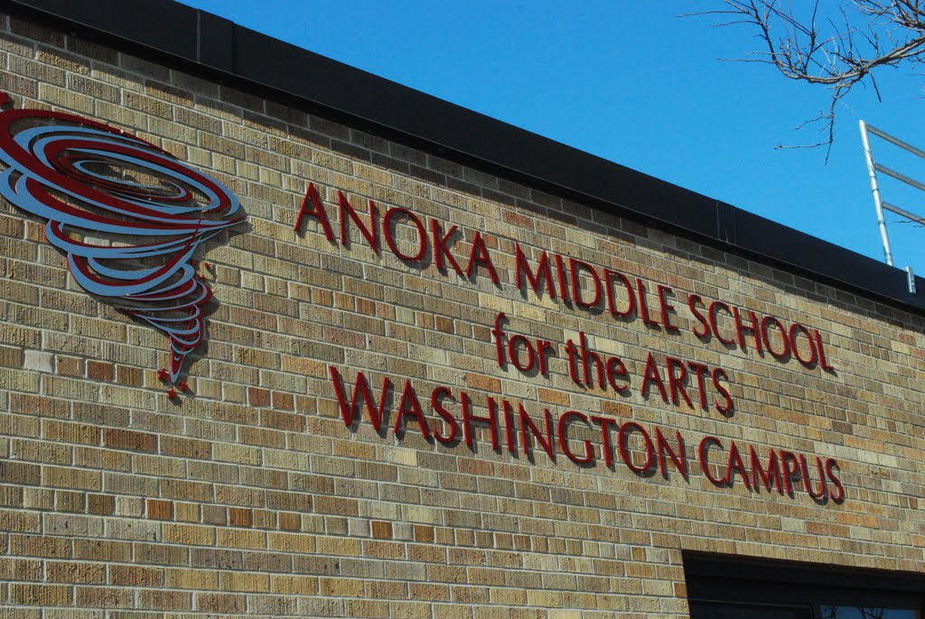
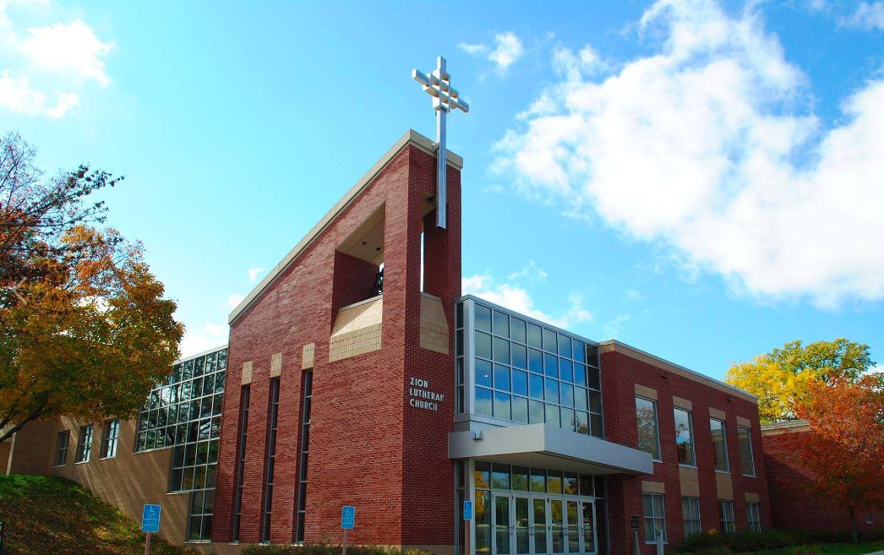
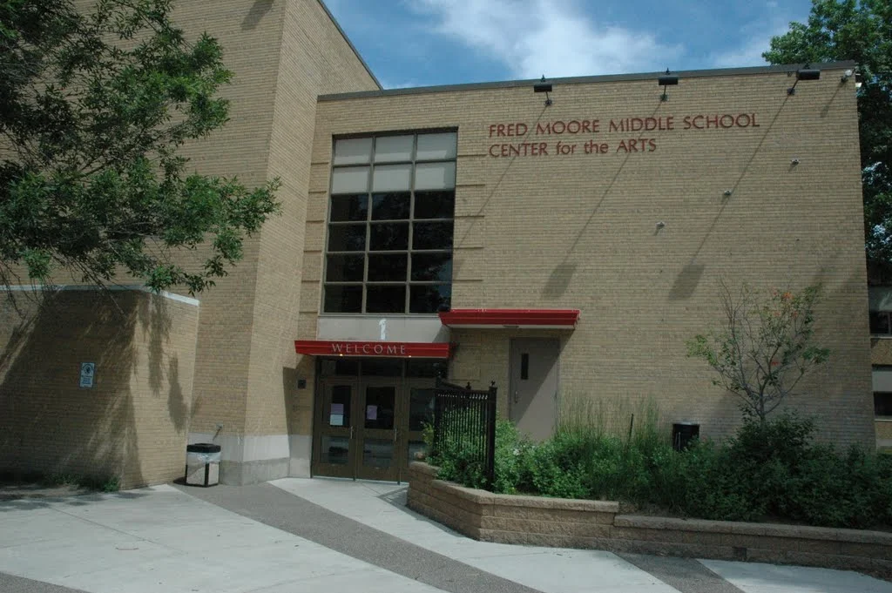
Anoka-Hennepin Faith Community Partnerships
Blaine High School & Chain of Lakes Church
Coon Rapids Middle School & Zion Lutheran Church
Mississippi Elementary & Coon Rapids United Methodist Church
Notes:
Blaine High School: Tiger Takeout
Coon Rapids Middle School: Winter break meal support
Mississippi Elementary: The Sheridan Story

Slide 49
Q & A
Evaluations – we value your feedback
www.compassionactionnetworkanoka.org

